Slide 1
Peacemakers
Blessed are the peacemakers,
for they will be called children of God.
Matthew 5:9
Notes:
CCHF about 8 years ago…
Medical Director x 6 months
Brewing tensions with DON, with providers, ES
Break down moment with Dr Jim Henderson
Ready to quit even before I had started
Ready to never head up a Christian organization ever!
Why am the one speaking on Peacemaking?
Not an expert….
Just someone who has had a lot of experience which for a topic like this may not be a good thing
As a Medical Director,
as a pastor,
as a husband,
as a father to three teenage children,
as a kid growing up in a lot of brokenness,
I’ve had a lot of experience in conflict done poorly and have also been fortunate enough to see conflict done well.

Slide 2
What does conflict look like in this room of humble,
Christ Followers?
Notes:
What does conflict look like in this room of humble,
Christ Followers?

Slide 3
Examples of Conflicts (I’ve heard about)
Your Nurse who is consistently late and on her cell phone
A Front staff who consistently works in pts during your lunch hour
Another provider who repeatedly prescribes controlled substances to your patient because they don’t like to be “mean”
Another provider who because they take more time with their patients, you end up seeing all the work-ins as well as your scheduled patients. Their reasoning is they give better care.
An Executive Staff who is pushing you to see more patients
A Patient who is demanding and verbally abusive to staff
Notes:
Examples of Conflicts (I’ve heard about)
SLIDE

Slide 4
Objectives
Why Peace?
Cost of Conflict
How do we promote Peace?
  Fostering a Culture of Peace
  Leading Peace
  Your posture towards conflict
  Navigating Conflict Wisely
Notes:
Objectives for today
SLIDE

Slide 5
Why Peace?
Conflict is inevitable
  Driven Personalities
  Limited Resources
  Busyness
A lot to be lost in conflict
Bondage!
We are called to reflect Christ including how He Reconciled Himself to us
A lot to be gained in doing conflict well
Notes:
SLIDE

Slide 6
Why Peace?
Peacemakers who sow in peace reap a harvest of righteousness
James 3: 18
Notes:
SLIDE

Slide 7
Cost of Conflict
Employees spent 2.8 hours per week dealing with conflict.
  = $359 billion in paid hours (based on avg of $17.95/hour)
  = approximately 400 million working days
25% of employees said that avoiding conflict led to sickness or absence from work.
nearly 10 percent reported that workplace conflict led to project failure
> one-third said conflict resulted in someone leaving the company, (firing or quitting)
Replacing an employee will cost you 150 to 200% more than that employee's salary and benefits.
Notes:
SLIDE

Slide 8
Cost of Conflict
Personally - Frustration, Disappointment, Burn out
Patients -Unsafe care
Staff - Disunity, loyalty, disconnect
Organization - Financial
      Lost time, lost productivity
      rehiring/training
      Legal
Families – Our joy at home, Our Legacy
Faith - Testimony
Notes:
SLIDE

Slide 9
What to Do?
Foster a culture of Peace
Lead Peace
Learn your posture towards conflict
Navigate Conflict Wisely
Notes:
SLIDE

Slide 10
What Determines a Culture of Peace vs Conflict?
PEACE CONFLICT
Mission
Respect /Value for Relationship
Communication
Approach to Conflict
Leadership (Style and View of)
Notes:
SLIDE

Slide 11
Components of a Culture of Peace
Committed to Mission
    Serve the Poor, Reflect Christ
Deep Respect & Value for Relationship
    Covenant Relationship
    Marked by Compassion, Trust, and Honesty
Communication
    Clear, Transparent
    Avoiding Gossip
    Honoring
Notes:
SLIDE

Slide 12
Components of a Culture of Peace
Approach to Conflict
    PeaceMaker vs PeaceFaker
    Grace Filled
    Fair and Gentle
    Quick to Confess, Quick to Forgive
Leadership Style
    S – Servant Leader
    H – Humble
    A – Accountable
    R – Respectful and Respectable
    P – Professional
Notes:
SLIDE

Slide 13
What do people want of their leaders?
Can I trust you?
Do you really care about me?
Can you actually help me?
How do people decide if you are approachable?
Notes:
What are people asking us as leaders?
What do you want to know of your leaders?
Can I trust you?
Will you maintain confidentiality?
Will you lose respect for me or judge me if I allow you to see how badly I’ve blown it?
Will you be gentle and patient even when I’m exasperating?
Will you reject me if I don’t do everything right?
Will you assume the best about me or will you jump to conclusions and blame me for all my problems?
Can I trust you with the "fine china" of my life?
Do you really care about me?
Are you just politely tolerating me or fulfilling an obligation?
Or do you really want to help me? Why?
How could anyone love a person with such problems?
Will you take time to listen to me?
Do you care enough to push past my outer defenses and take time to help me sort out the tangled mess in my heart?
Will you love me like Jesus does, even when I’m not very loveable?
Can you actually help me?
Are you competent to deal with my issues?
How are you doing with your own challenges and struggles?
Do you have a track record of successfully solving these kinds of problems?
What kind of training or experience do you have?
If this problem is beyond the two of us, do you have the humility and wisdom to help me find another person who has the experience I need?
How do people decide if you are approachable?
Track Record

Slide 14
What does your track record say about your leadership?
Gossipy
Sarcastic and condescending
Irritable and annoyed
Rushed and uncaring
How you talk about your
  Patients, family, church, friends, your leaders
How you talk …. on social media
Notes:
SLIDE

Slide 15
Approachable Leader 101
Maintain a “gentle authority slope” (Fight pride and cultivate true humility)
Guard against institutional dynamics that undermine approachability
Send convincing signals that you have time for people
Pick up on Hints
Ask “why are they talking to you about this”
  “What hat or role do they want me to play?”
Listen Deeply, before …
  Jumping to problem solving
  Confronting sin in others
Quick to confess your own sin, whether small or large
Make yourself accountable to others
Notes:
SLIDE

Slide 16
Under-Protecting a Leader
allowing gossip and rumors to spread unchecked
  Quiet agreement
  Body language
  Overt contribution to comments
jumping to conclusions about a leader's guilt
failing to give him a meaningful opportunity to defend himself
Fosters a "culture of criticism"
Notes:
Being an approachable leader is one thing but how we protect our leaders is also critical!
SLIDE

Slide 17
Over-Protecting a Leader
blind loyalty that compels them to become defensive when a leader is questioned or accused of wrongdoing.
assume the challenge must be unfounded and immediately look for ways to minimize it or explain it away.
rely on second-hand information or simply accept the leader's interpretation of his accuser's words and motives.
in an effort to justify or protect the leader, they attempt to silence, find fault with, or otherwise discredit or penalize the person who brought the accusation.
Fosters a culture of denial
Notes:
SLIDE

Slide 18

Posture of Peace
How do we approach conflict?
Notes:
So when there is a conflict, how do we approach it?

Slide 19
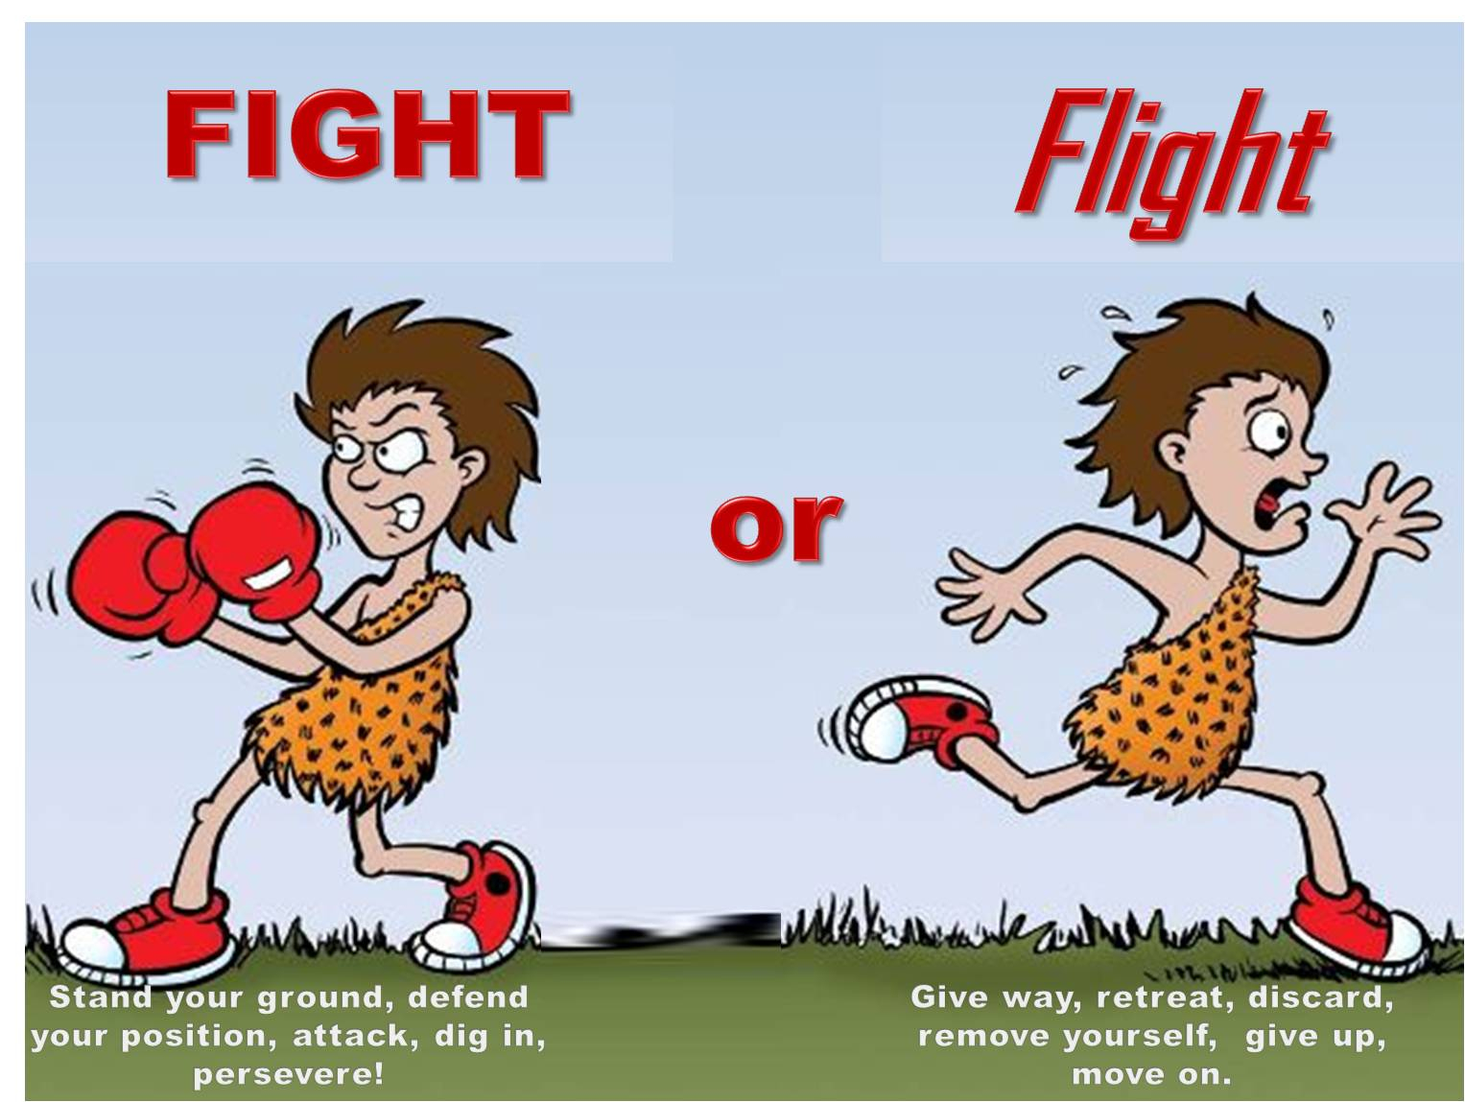
If Conflict invokes this…
Notes:
SLIDE

Slide 20


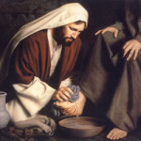
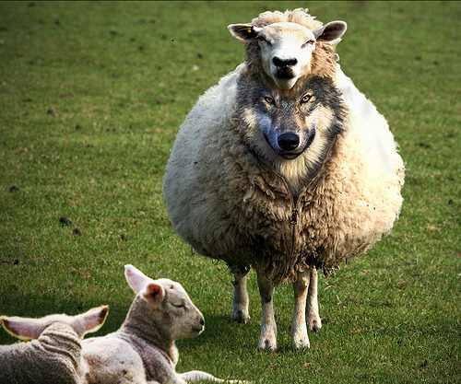

How do you approach conflict?
Notes:
How do you approach conflict?
An angry bear
Wolf in sheeps clothing
As friends
As a team
Or as a servant?

Slide 21
How do you want others addressing conflict with you?
Do’s and Don’ts
Notes:
When someone has had an issue with you,
what have they done well?
What have they done poorly?

Slide 22
Don’t…
Respond in haste
Public Humiliation
Sarcasm
Go straight to supervisor
“You” statements
Language of Extremes (always, never, everyone)
Talk about others (compare)
No room to redeem
Gossip
Notes:
SLIDE

Slide 23
Do…
Allow time to process
Know your facts
Open to correction
Be prayerful
Seek Counsel
Consider the venue
Be encouraging
Convey your heart
Be direct
Open to explanation
Allow graceful exit
Review Impact
Offer hope and restoration
Know your limits
Follow chain of command
Know your end game
Notes:
SLIDE

Slide 24
What is your End Game
Prove something?
Affirmation that you are right?
Remorse?
Confession?
That you are heard?
Change?
Notes:
SLIDE

Slide 25
unitatem in necessariis, in non necessariis libertatem, in omnibus caritatem
Unity in essential things
Liberty in doubtful things
Charity (love) in all things.
Archbishop of Spalato, Marco Antonio de Dominis

Slide 26
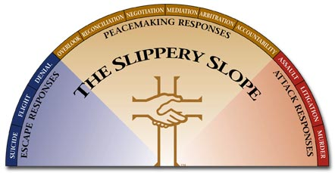
Notes:
SLIDE

Slide 27
2 Extremes
Escape
Attack
Denial
Avoid
Nothing is wrong
Flight
Suicide
Assault
Verbal
Gossip
Litigation
Murder
Peace is in between!
Notes:
SLIDE

Slide 28
Navigating the “in between”
Personal Response
Overlook an Offense
Reconciliation
Negotiation
Mediated Response
Mediation
Arbitration
Accountability
Notes:
SLIDE

Slide 29
Seven A’s of Confession
Address everyone involved
Avoid “If,” “ but,” “maybe”
Admit specifically
Acknowledge the hurt
Accept the consequences
Ask for forgiveness – “Will you forgive me?”
Alter your behavior
Notes:
SLIDE

Slide 30
Four Promises of Forgiveness
I will not dwell on this incident
I will not use this incident against you
I will not talk to others about this incident
I will not allow this incident to stand between us or hinder our personal relationship
Notes:
SLIDE

Slide 31
The bee collects honey from flowers in such a way as to do the least damage or destruction to them, and he leaves them whole, undamaged and fresh, just as he found them. True devotion does still better. Not only does it not injure any sort of calling or occupation, it even embellishes and enhances it.
Moreover, just as every sort of gem, cast in honey, becomes brighter and more sparkling, each according to its color, so each person becomes more acceptable and fitting in his own vocation when he sets his vocation in the context of devotion.
Through devotion your family cares become more peaceful, mutual love between husband and wife becomes more sincere, the service we owe to the prince becomes more faithful, and our work, no matter what it is, becomes more pleasant and agreeable.
- Francis de Sales - Devotion
Notes:
Francis de Sales – Devotion
The bee collects honey from flowers in such a way as to do the least damage or destruction to them,
and he leaves them whole, undamaged and fresh, just as he found them.
True devotion does still better. Not only does it not injure any sort of calling or occupation, it even embellishes and enhances it.
Moreover, just as every sort of gem, cast in honey, becomes brighter and more sparkling,
each according to its color,
so each person becomes more acceptable and fitting in his own vocation when he sets his vocation in the context of devotion.
Through devotion your family cares become more peaceful,
mutual love between husband and wife becomes more sincere,
the service we owe to the prince becomes more faithful,
and our work, no matter what it is, becomes more pleasant and agreeable.

