Slide 1
The Spiritual History
Global Health Missions Conference
Southeast Christian Church – Louisville, KY
Saturday, November 7, 2013
Walter L. Larimore, M.D.
Clinical Professor, In His Image Family Medicine Residency, Tulsa, OK
Asst Clinical Prof, Dept of Family Medicine, Univ. of Colorado, Denver, CO

Slide 2
Learning to Share Your Faith in Your Practice

Slide 3
Module 2
The Importance of a Spiritual History to Quality Patient Care
Walt Larimore, MD

Slide 4
POLL
If an attending said, “It's inappropriate to take a spiritual history!”, I would say:
I don’t know how I’d respond.
“OK, thanks for advising me.”
“Actually, I’ve been told it’s a part of quality care.”

Slide 5
Benefit Statement
Current research, patient openness, evidence-based clinical guidelines, and biblical precedent all suggest the importance and appropriateness of a holistic approach to quality patient care—which includes a spiritual assessment for many, if not most, patients.

Slide 6
Learning Objectives
At the end of this presentation, the participant should be able to:
  Discuss why a spiritual history, when indicated, is not only appropriate in healthcare, but considered part of quality healthcare.
  Choose a spiritual history template to begin using with patients.

Slide 7
Key Questions
Why is a spiritual history in the clinical practice of healthcare appropriate?
What are the benefits of a spiritual history for the patient and the healthcare professional in clinical practice?
What are some examples of spiritual history templates that have proven effective and easy to use in clinical practice?
Notes:
TO WALT

Slide 8
Spirituality for Patients
Notes:
WALT
There are many practical reasons why addressing spiritual issues in clinical practice is important.
Here are a few (and these are not exhaustive).

Slide 9
Patient Needs
“Many patients are R/S (religious or spiritual) and have spiritual needs related to medical or psychiatric illness.”
“Studies of medical and psychiatric patients and those with terminal illnesses report that the vast majority have such needs, and most of those needs currently go unmet.”
Koenig H. ISRN Psychiatry 2012. Article ID 278730
Religion, Spirituality, and Health: The Research and Clinical Implications
http://www.hindawi.com/isrn/psychiatry/2012/278730/
Notes:
Harold Koenig, MD, is a psychiatrist at Duke and one of the leading researchers on the relationships between religion/spirituality and health. In a 2012 systematic review, titled, “Religion, Spirituality, and Health: The Research and Clinical Implications,” wrote …

Slide 10
Patient Needs
“Unmet spiritual needs, especially if they involve R/S (religious or spiritual) struggles, can adversely affect health and may increase mortality independent of mental, physical, or social health.”
“(Furthermore), R/S (religion and spirituality) influences the patient’s ability to cope with illness.”
Koenig H. ISRN Psychiatry 2012. Article ID 278730.

Slide 11
Patient Needs
“In some areas of the country, 90% of hospitalized patients use religion to enable them to cope with their illnesses and over 40% indicate it is their primary coping behavior.”
“Poor coping has adverse effects on medical outcomes, both in terms of lengthening hospital stay and increasing mortality.”
Koenig H. ISRN Psychiatry 2012.

Slide 12
Medical Decision Making
“R/S (religious or spiritual) beliefs affect patients’ medical decisions, may conflict with medical treatments, and can influence compliance with those treatments.
“Studies have shown that R/S beliefs influence medical decisions among those with serious medical illness and especially among those with advanced cancer or HIV/AIDs.”
Koenig H. ISRN Psychiatry 2012.

Slide 13
Medical Outcomes
“R/S (religion and spirituality) is associated with both mental and physical health and likely affects medical outcomes.”
Koenig H. ISRN Psychiatry 2012.

Slide 14
Medical Costs
“Research shows that failure to address patients’ spiritual needs increases healthcare costs, especially toward the end of life.”
This is a time when patients and families may demand medical care (often very expensive medical care) even when continued treatment is futile.”
Koenig H. ISRN Psychiatry 2012.
Notes:
For example, patients or families may be praying for a miracle.
“Giving up” by withdrawing life support or agreeing to hospice care may be viewed as a lack of faith or lack of belief in the healing power of God.
If health professionals do not take a spiritual history so that patients/families feel comfortable discussing such issues openly, then situations may go on indefinitely and consume huge amounts of medical resources.

Slide 15
Influences Support
“R/S influences the kind of support and care that patients receive once they return home. A supportive faith community may ensure that patients receive medical follow-up (by providing rides to doctors’ offices) and comply with their medications.”
“It is important to know whether this is the case or whether the patient will return to an apartment to live alone with little social interaction/support.”
Koenig H. ISRN Psychiatry 2012.

Slide 16
Spirituality for Patients
“Therefore, health professionals need to know about such influences, just as they need to know if a person smokes cigarettes or uses alcohol or drugs.
“Those who provide healthcare to the patient need to be aware of all factors that ‘influence health and healthcare.’”
Koenig H. ISRN Psychiatry 2012.

Slide 17
Actual Practice
Research shows that most healthcare professionals believe spiritual wellbeing is an important factor; however, they…
  are often reluctant to explore spiritual issues with their patients
  report infrequent discussions of spiritual issues
  report infrequent referrals to chaplains
Ellis M, et al J Fam Pract 1999(Feb);48(2):105-09.
Notes:
Most healthcare professionals believe spiritual well-being is an important factor in health.
Despite this belief, however, most report infrequent discussions of spiritual issues with patients and infrequent referrals of hospitalized patients to chaplains.

Slide 18
Reasons for Not Taking a Spiritual History
Lack of time 71%
Lack of experience or training 59%
Uncertainty about how to:
  Take a spiritual history 59%
  Identify patients who desire spiritual
  discussion 56%
  Manage spiritual issues brought up 49%
Ellis M, et al J Fam Pract 1999(Feb);48(2):105-09.
Notes:
Data from: Ellis M, et al. Addressing spiritual concerns of patients: family physicians' attitudes and practices. J Fam Pract 1999(Feb);48(2):105-09.
To Eliminate These Concerns …
We’ll show you how (and why) a spiritual history can and should be taken with each and every patient of yours.
We’ll show you how you (or an assistant) can take a spiritual history utilizing minimal time.
In later sessions, we’ll discuss how to manage any spiritual issues that may come up.

Slide 19
Academic Opposition

Slide 20
Richard P. Sloan, PhD
Director of the Behavioral Medicine Program at Columbia-Presbyterian Medical Center in New York.
In his book Blind Faith (2006), he argues that religion and medicine should be kept separate.
Koenig HG, King DE, Carson VB. Handbook of Religion and Health.
Oxford University Press. 2012:62.

Slide 21
Richard P. Sloan, PhD
Sloan claims that “it is dangerous for doctors to begin addressing the spiritual needs of patients.”
According to Koenig, King, and Carson, “Sloan has become the world’s most vocal critic of the religion-health relationship, and in Blind Faith, cynically and caustically elaborates his one-sided, extremist views that are not evidence-based.”
Koenig HG, King DE, Carson VB. Handbook of Religion and Health.
Oxford University Press. 2012:62.

Slide 22
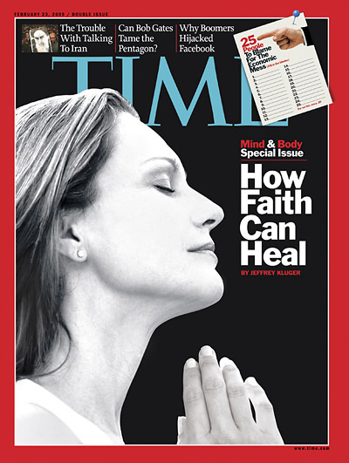
Academic Opposition
February 23, 2009
Notes:
Sloan continues his extremist views in a 2009 article in Time magazine.

Slide 23
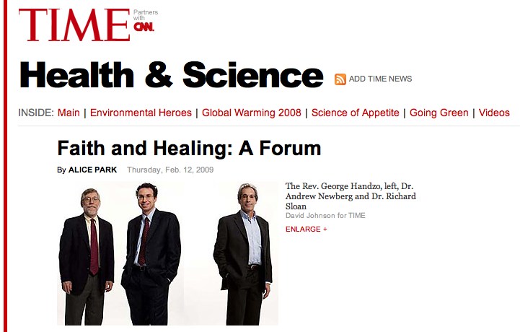
Academic Opposition
February 23, 2009
Notes:
A forum on faith and healing was hosted by Time reporter Alice Park. She interviewed three professionals including Richard P. Sloan, PhD.

Slide 24
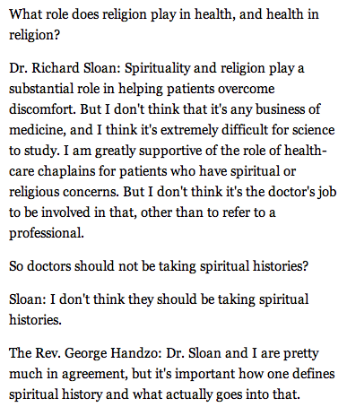
Notes:
In the Time magazine article Sloan is quoted as admitting, “Spirituality and religion play a substantial role in helping patients overcome discomfort. But I don’t think that it’s any business of medicine.
Sloan goes on to say, “I don’t think it’s the doctor’s job to be in involved in that, other than to refer to a professional.
Does he not think doctors are professionals?

Slide 25
Notes:
When Ms. Park then said, “So doctors should not be taking spiritual histories?” Dr. Sloan answered, “I don’t think they should be taking spiritual histories.”
Dr. Sloan, as we discussed in an earlier session, holds a very strong opinion – and one that is not rare in academic circles, especially among mental and behavioral health professionals.
However, we believe his opinion is NOT evidence based and is in the minority.
So, on what basis do we recommend you consider taking a spiritual history from most if not all of your patients?

Slide 26
Why Take a Spiritual History?

Slide 27
Why Take a Spiritual History?
Patient desire
Patient benefit
May identify a significant risk factor
May enhance healthcare, and because of these reasons
Considered a quality standard of care
Notes:
We suggest there are at least five evidence-based reasons you should learn to take a spiritual history with your patients.

Slide 28
Patient Desire

Slide 29
Patient Desire
With 70% of the population who view religious commitment is a central life factor …
“Treatment approaches devoid of spiritual sensitivity may provide an alien values framework.”
“A majority of the population probably prefers an orientation … that is sympathetic, or at least sensitive, to a spiritual perspective.”
Bergin AE, et al. Religiosity of psychotherapists:
A national survey. Psychotherapy 1990,27,3-7.

Slide 30
Patient Desire
“In general, the public appears to view and value spirituality …
as a central factor of life … especially when they are facing illness and …
desires healthcare professionals to inquire about beliefs that are important to them.”
Hatch RL, et al. J Fam Pract 1998;46(6):476-86.
Notes:
In general, the public appears to view and value spirituality as a central factor in their lives, especially when they are facing illness, and…
Desires for healthcare professionals to inquire about beliefs that are important to them.

Slide 31
Patient Desire
“In general, the majority of patients would not be offended by gentle, open inquiry about their spiritual beliefs by physicians.
“Many patients want their spiritual needs addressed by their physician directly or by referral to a pastoral professional.”
MacLean CD, et al. J Gen Intern Med. 2003(Jan);18(1):38–43.

Slide 32
Patient Benefit

Slide 33
Patient Benefit
Of studies reporting relationships between R/S and mental or physical health:
  ~1,600 (~70%) of the studies reported positive relationships,
  ~500 (~22%) of the studies reported no or mixed relationships, and
  ~200 (~9%) of the studies reported negative relationships (4% of the mental health studies and 8.5% of the physical health studies).
Handbook of Religion and Health. Oxford University Press. 2012:601-602.
Notes:
And about 1400, or about 61%, of these studies were rated high or higher quality studies (greater than 7/10 on the Cooper Rating Scale).

Slide 34
Patient Benefit
“Science has demonstrated that being devout provides more health benefits than not being devout.”
Dale Matthews, MD
Matthews DA. Quoted in: Sabom M. Light and Death. Grand Rapids: Zondervan. 1998.
Notes:
Matthews goes on to point out, “We haven’t shown that being a devout Christian will make you healthier than being a devout Buddhist.

Slide 35
Identification of Risk Factors

Slide 36
Morbidity and Mortality
Morbidity and mortality of various types
“We’ve known for decades that infrequent religious attendance should be regarded as a consistent risk factor for morbidity and mortality of various types – both physical and mental.”^{1,2}
We have an entire module on the “Faith-Health Connection” available for additional study.
1. Levin JS, et al. Soc Sci Med 1987;24(7):589-600.
2. Koenig, et al. Handbook of Religion and Health. 2nd edition.

Slide 37
Negative Effects of Religious Struggle
A longitudinal cohort study from 1996 to 1997 was conducted to assess religious struggle and demographic, physical health, and mental health measures.
Mortality during the two-year period was the main outcome measure.
Participants were 596 patients aged 55 years or older on the medical inpatient services of Duke University Medical Center
Pargament KI, et al. Arch Intern Med 2001;161:1881-1885.

Slide 38
Negative Effects of Religious Struggle
After controlling for the demographic, physical health, and mental health variables,
  Higher religious struggle scores at baseline were predictive of 6% greater risk of mortality (RR for death, 1.06; 95% CI, 1.01-1.11; P = 0.02).
  Patients’ reports that they felt alienated from or unloved by God or attributed their illness to the devil were associated with a 19% to 28% increase in risk of dying during the two-year follow-up period.
Pargament KI, et al. Arch Intern Med 2001;161:1881-1885.

Slide 39
Negative Effects of Religious Struggle
These specific items were identified as the strongest predictors of increased risk for mortality:
  "Wondered whether God had abandoned me" (28% increased risk: RR, 1.28; 95% CI, 1.07-1.50; P = .02),
  "Questioned God's love for me" (22% increased risk: RR, 1.22; 95% CI, 1.02-1.43; P = .05), and
  "Decided the devil made this happen" (19% increased risk: RR, 1.19; 95% CI, 1.05-1.33; P = .02).
  "Felt punished by God for my lack of devotion” (16% increased risk: RR, 1.16; 95% CI, 1.00-1.32; P<.06).
Pargament KI, et al. Arch Intern Med 2001;161:1881-1885.

Slide 40
Negative Effects of Religious Struggle
This is the first empirical study to identify religious variables that increase the risk of mortality.
Men and women who experience a religious struggle with their illness appear to be at increased risk of death, even after controlling for baseline health, mental health status, and demographic factors.
Pargament KI, et al. Arch Intern Med 2001;161:1881-1885.

Slide 41
Negative Effects of Religious Struggle
“Such patients may, without their doctor’s encouragement, refuse to speak with clergy because they are angry with God and have cut themselves off from this source of support.”
Koenig, HG. JAMA. 2002;288(4):487-493.

Slide 42
May Enhance Healthcare

Slide 43
May Enhance Healthcare
“The empirical literature ... regarding the relationship between religious factors and physical and mental health status ... was reviewed.”
Matthews DA, et al. Religious commitment and health status: A review of the research and implications for family medicine. Arch Fam Med 1998;7(2):118-124.
Notes:
Religious factors included:
frequency of religious attendance,
private religious involvement, and
relying on one's religious beliefs as a source of strength and coping.
In particular, studies were highlighted that examined the role of religious commitment and religious involvement in:
the prevention of illness,
coping with illness that had already arisen, and
recovery from illness.

Slide 44
May Enhance Healthcare
“A large proportion of published empirical data suggest that religious commitment plays a beneficial role in:
  in preventing mental/physical illness,
  improving how people cope with mental and physical illness, and
  facilitating recovery from illness.”
Matthews DA, et al. Religious commitment and health status: A review of the research and implications for family medicine. Arch Fam Med 1998;7(2):118-124.
Notes:
“If we had a single pill that did these three things, it would outsell Viagra.”
Walt Larimore, MD

Slide 45
May Enhance Healthcare
Matthews, et al. conclude:
  “The available data suggest that practitioners who make several small changes in how patients’ religious commitments are broached in clinical practice may enhance healthcare outcomes.”
Matthews DA, et al. Religious commitment and health status: A review of the research and implications for family medicine. Arch Fam Med 1998;7(2):118-124.

Slide 46
May Enhance Healthcare
Matthews, et al. conclude:
  “The available data suggest that practitioners who make several small changes in how patients’ religious commitments are broached in clinical practice may enhance healthcare outcomes.”
Matthews DA, et al. Religious commitment and health status: A review of the research and implications for family medicine. Arch Fam Med 1998;7(2):118-124.
Notes:
And we believe that a spiritual history is one of these “small changes.”

Slide 47
Standard of Care
American Psychiatric Assn. (1989);
American Psychological Assn. (1992);
Accreditation Council for GME (1994);
Council on Social Work Education (1995);
Joint Commission (1996);
American Academy of Family Physicians (1997);
American College of Physicians,
Assn. of American Medical Colleges (1998).
Notes:
In the 1990’s, professional organizations increasingly called for greater sensitivity and better training of clinicians concerning the management of religious and spiritual issues in the assessment and treatment of patients.

Slide 48
Standard of Care
“Today, nearly 90% of medical schools (and many nursing schools) in the U.S. include something about religion/spirituality in their curricula and this is also true to a lesser extent in the United Kingdom and Brazil.”
Thus, spirituality and health is increasingly being addressed in medical and nursing training programs as part of quality patient care.
  Koenig HG, et al. Spirituality in medical school curricula:
  Findings from a national survey. Int J Psy Med 2010;40(4):391-8
Notes:
Professional organizations increasingly are calling for greater sensitivity and better training of clinicians concerning the management of religious and spiritual issues in the assessment and treatment of patients.

Slide 49
Standard of Care
A spiritual history is required by the Joint Commission for long-term care, home care, behavioral care, and hospital admission.
  The spiritual history “should, at a minimum, determine the patient's denomination, beliefs, and what spiritual practices are important to them.”
  “This information would assist in determining the impact of spirituality, if any, on the care and/or services being provided and will identify if any further assessment is needed.”
Notes:
The Joint Commission. Advancing Effective Communication, Cultural Competence, and Patient- and Family-Centered Care: A Roadmap for Hospitals. Oakbrook Terrace, Ill.: The Joint Commission; 2010.

Slide 50
Standard of Care
What would I recommend in terms of addressing spiritual issues in clinical care?
First and foremost, health professionals should take a brief spiritual history.
This should be done for all new patients on their first evaluation, especially if they have serious or chronic illnesses, and when a patient is admitted to a hospital, nursing home, home health agency, or other healthcare setting.
Koenig H. ISRN Psychiatry 2012. Article ID 278730.

Slide 51
Standard of Care
The purpose of a spiritual history is to learn five key items:
  The patient’s religious background,
  The role that religious or spiritual beliefs or practices play in coping with illness (or causing distress),
  Koenig H. ISRN Psychiatry 2012.

Slide 52
Standard of Care
The purpose of a spiritual history is to learn:
  Beliefs that may influence or conflict with decisions about medical care,
  The patient’s level of participation in a spiritual community and whether the community is supportive, and
  Any spiritual needs that might be present.
  Koenig H. ISRN Psychiatry 2012.

Slide 53
Standard of Care
Ideally, the doctor, as head of the medical/dental care team, should take the spiritual history.
“It is the healthcare professional, not the chaplain, who is responsible for doing this two-minute ‘screening’ evaluation. Simply recording the patient’s religious denomination and whether they want to see a chaplain, the procedure in most hospitals today, is NOT taking a spiritual history.”
  Koenig H. ISRN Psychiatry 2012.

Slide 54
So what spiritual history questions could I consider?
Available instruments that are short and sweet
Notes:
Most healthcare professionals find it easiest and most comfortable to include three or four spiritual assessment questions during their social history – when asking about marriage, work, tobacco use, alcohol use, drug use, etc.
From the following examples, see if you can come up with a few questions that you might be comfortable incorporating into your practice.

Slide 55
Open Invite
The Open Invite is a patient-focused approach to encouraging a spiritual dialogue.
It is structured to allow patients who are spiritual to speak further, and to allow those who are not so inclined to easily opt out.
First, it reminds physicians that their role is to open the door to conversation and invite (never require) patients to discuss their needs.
  Saguil A, et al. The Spiritual Assessment. Am Fam Physician 2012;86(6):546-550.
Notes:
Saguil A, et al. The Spiritual Assessment. Am Fam Physician 2012;86(6):546-550.

Slide 56
Open Invite
First, it reminds physicians that their role is to open the door to conversation and invite (never require) patients to discuss their needs.
Second, it provides a mnemonic for the general types of questions a physician may use.

Slide 57
Open Invite
The tool provides questions that allow the physician to broach the topic of spirituality.
Questions may be similar to those used in the FICA, HOPE, or GOD mnemonics, or may be customized.

Slide 58
Open
Open (i.e., open the door to conversation)
  May I ask your faith background?
  Do you have a spiritual or faith preference?

Slide 59
Invite
Invite (the patient to discuss spiritual needs):
  Do you feel that your spiritual health is affecting your physical health?
  Does your spirituality impact the health decisions you make?
  Is there a way in which you would like for me to account for your spirituality in your care?
  Is there a way we can provide spiritual support?
  Are there resources in your faith community that you would like for me to help mobilize?

Slide 60
FICA History
The FICA Spiritual History Tool uses an acronym to guide health professionals through a series of questions designed to elicit patient spirituality and its potential effect on healthcare.
Starting with queries about faith and belief, it proceeds to ask about their importance to the patient, the patient’s community of faith, and how the patient wishes the professional to address spirituality in his or her care.
Puchalski CM. Taking a Spiritual History: FICA. Spirituality and Medicine Connection 1999:3:1.

Slide 61
FICA History
F = Faith: Do you have spiritual beliefs that help you cope? If the patient responds “no,” consider asking: What gives your life meaning or hope?
I = Importance: Have your beliefs influenced how you take care of yourself in this illness?
C = Community: Are you part of a spiritual community? Is this of support to you? If so, how?
A = Address: How would you like me to address these issues in your healthcare? Are there any spiritual resources you might need?
Puchalski CM. Spirituality and Medicine Connection 1999:3:1.

Slide 62
Hope History
The HOPE questions are another tool.
These questions lead the healthcare professional from general concepts to specific applications by asking about patients’ sources of hope and meaning, whether they belong to an organized religion, their personal spirituality and practices, and what effect their spirituality may have on medical care and end-of-life decisions.
Anandarahah G, et al. Spirituality and Medical Practice: Using the HOPE Questions as a Practical Tool for Spiritual Assessment. Am Fam Physician 2001(Jan);63(1):81-89.

Slide 63
Hope History
H = Hope: What sources of hope, strength, comfort, meaning, peace, love, and connection do you have? What do you hold on to during difficult times?
O = Organized religion: Are you part of a religious or spiritual community? Does it help you? If so, how?

Slide 64
Hope History
P = Personal spirituality or practices: Do you have personal religious or spiritual beliefs? What aspects of your spirituality or spiritual practices do you find most helpful?
E = Effects on care. Is there anything that I can do to help you access the spiritual resources that usually help you? Are there any specific practices or restrictions I should know about in providing your medical care?

Slide 65
SPIRITual History
S = Spiritual belief system: Do you have a formal religious affiliation? Do you have a spiritual life that is important to you?
P = Personal spirituality: In what ways is your religion or spirituality meaningful to you?
I = Integration with faith community: Do you participate in a faith community? What support does this group give you?
Maugans TA. The SPIRITual History. Arch Fam Med 1996;5:11-16.

Slide 66
SPIRITual History
R = Ritualized practices and restrictions: What specific lifestyle activities or practices does your religion/spirituality encourage?
I = Implications for medical practice: What aspects of your R/S would you like me to keep in mind as I care for you?
T = Terminal events planning: Will your R/S influence your end-of-life decisions?
Maugans TA. The SPIRITual History. Arch Fam Med 1996;5:11-16.

Slide 67
FAITH Spiritual History
F = Faith: Do you have a spiritual faith or religion that is important to you?
A = Apply: How do your beliefs apply to your health?
I = Involved: Are you involved in a faith community?
T = Treatment: How do your spiritual views affect your views about treatment?
H = Help: How can I help you with any spiritual concerns?
King DE. In Mengal, et al. Fundamentals of Clinical Practice. 2002.

Slide 68
CSI MEMO History
CS = Comfort/Stress: Do your R/S beliefs provide comfort or are they a source of stress?
I = Influence: Do you have R/S beliefs that might influence your medical decisions?
MEM = Member: Are you a member of a R/S community and is it supportive to you?
O = Other: Do you have other spiritual needs you’d like someone to address?
Koenig HG. JAMA. 2002;288(4):487-493.

Slide 69
Larson Spiritual History
Do you attend religious services? If so, how often do you generally attend?
Aside from attending religious services, would you say that religion is important to you?
Do you pray? If so, how frequently?
Larson DB. Personal communication to Walt Larimore, MD. 1990.

Slide 70
GOD Questions
G = God: Is God, spirituality, religion, or spiritual faith important to you?
O = Others: Do you meet with others in religious or spiritual community? If so, how often? How do you integrate with your faith community?
D = Do: What can I do to assist you in incorporating your spiritual or religious faith into your medical care? Or, is there anything I can do to encourage your faith? May I pray with or for you?
Larimore W, Peel WC. The Saline Solution: Sharing Christ in a Busy Practice. Christian Medical & Dental Assns. 2000.

Slide 71
A Word of Caution
Don’t be pushy.
BUT
Don’t ignore.

Slide 72
A Word of Caution
“Professional problems can occur when well-meaning physicians ‘faith-push’ a patient opposed to discussing religion …
“However, rather than ignoring faith completely with all patients, most of whom want to discuss it, physicians might ask a question to discern who would like to pursue it and who would rather not.”
Post. Mind Body Med 1997;2:44-8.

Slide 73
Incorporating Spiritual Needs
Listen
Respect and Clarify
Document
Consider
Saguil A, et al. The Spiritual Assessment. Am Fam Physician 2012;86(6):546-550.

Slide 74
Listen
The most basic thing a healthcare professional can do is to listen compassionately.
Empathetic listening may be all the support a patient requires.
By listening, even for just a few seconds, the healthcare professional signals his or her care for their patients and recognition of this dimension of their lives.
Saguil A, et al. The Spiritual Assessment. Am Fam Physician 2012;86(6):546-550.
Saguil A, et al. The Spiritual Assessment. Am Fam Physician 2012;86(6):546-550.

Slide 75
Respect and Clarify
The religious or spiritual beliefs of patients uncovered during the spiritual history should always be respected.
Even if beliefs conflict with the medical treatment plan or seem bizarre or pathological, the health professional should not challenge those beliefs (at least not initially), but rather take a neutral posture and ask the patient questions to obtain a better understanding of the beliefs.
Koenig H. ISRN Psychiatry 2012.

Slide 76
Respect and Clarify
Challenging patients’ religious/spiritual beliefs (at least initially) is almost always followed by resistance from the patient, or quiet noncompliance with the medical plan.
If the health professional is knowledgeable about the patient’s spiritual beliefs and the beliefs appear generally healthy, however, it would be appropriate to actively support those beliefs and conform the healthcare being provided to accommodate the beliefs.
Koenig H. ISRN Psychiatry 2012.

Slide 77
Document
Always document your spiritual assessment and your patient’s openness to discussing the topic.
You may find this information helpful when readdressing the subject in the future.
This documentation also helps meet any regulatory requirements for conducting a spiritual assessment.
Saguil A, et al. The Spiritual Assessment. Am Fam Physician 2012;86(6):546-550.

Slide 78
Consider
Consider how different traditions and practices may affect standard medical practice.
Health professionals should learn about the religious/spiritual beliefs and practices of different religious traditions that relate to healthcare, especially the faith traditions of patients they are likely to encounter in their particular country or region of the country.
Koenig H. ISRN Psychiatry 2012.

Slide 79
Consider
A brief description of beliefs and practices for health professionals related to birth, contraception, diet, death, and organ donation is provided here:
H. G. Koenig, “Information on specific religions,” in Spirituality in Patient Care, ch 13, pp. 188–227, Templeton Press, Conshohocken, PA, 2nd edition, 2007.

Slide 80
Consider
For instance, patients of the Jehovah’s Witness tradition tend to refuse blood transfusion;
Believers in faith healing may delay traditional medical care in hopes of a miracle; and
Muslim and Hindu women tend to decline sensitive (and sometimes general) examinations by male physicians.
Notes:
For instance, patients of the Jehovah's Witness tradition tend to refuse blood transfusion;
Believers in faith healing may delay traditional medical care in hopes of a miracle; and
Muslim and Hindu women tend to decline sensitive (and sometimes general) examinations by male physicians.

Slide 81
Consider
Also, many Muslims fast during Ramadan, which may affect glucose control and other physiologic factors in the ambulatory and inpatient settings.
Persons of some faiths observe strict dietary codes, such as halal and kosher laws, which may require physicians to alter nutrition counseling.
It is important to remember, however, that patients may not adhere to each specific belief of their faith.
Notes:
Also, many Muslims fast during Ramadan, which may affect glucose control and other physiologic factors in the ambulatory and inpatient settings.
Persons of some faiths observe strict dietary codes, such as halal and kosher laws, which may require physicians to alter traditional nutrition counseling.
It is important to remember, however, that patients may not adhere to each specific belief of their faith.

Slide 82
Consider
There are many such beliefs and practices that will have a direct impact on the type of care being provided, especially when patients are hospitalized, seriously ill, or near death.
Koenig H. ISRN Psychiatry 2012.

Slide 83
Summary
Assessing and integrating patient spirituality into the healthcare encounter can build trust and rapport, broadening the physician-patient relationship and increasing its effectiveness.
Saguil A, et al. Am Fam Physician 2012;86(6):546-550.

Slide 84
Summary
Most of all, the spiritual history allows us, as followers of Jesus and Christian healthcare professionals, to find out where our patients are in their spiritual journeys.
It allows us to see if God is already at work in their lives and join Him there in His work.
Notes:
TO BILL

Slide 85
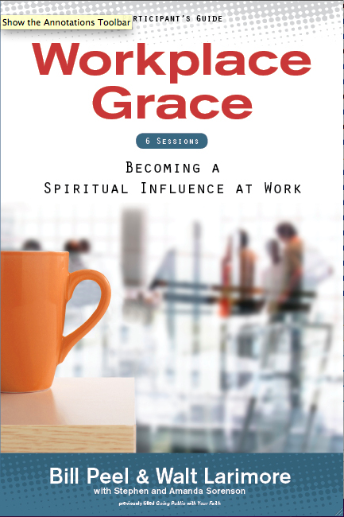



Slide 86
Let’s Talk
Comments?
Questions?

Slide 87
For a copy of the
handout write
WaltLarimore@mac.com

Slide 88
Coming Next Spring … from CMDA
Grace Prescriptions
A small-group curriculum for Christian healthcare professionals to discuss together how they can bring their faith to work each day and with each patient.

Slide 89
Two Free Blog Subscriptions for You
Medical News You Can Use
Short evidence-based daily blogs with hyperlinks to sources.
www.DrWalt.com/blog
Morning Glory, Evening Grace
Twice daily, topical, Biblical devotions with hyperlinks to Scriptural sources.
www.Devotional.DrWalt.com

Slide 90
Personal Application
What are the implications of this material for my current situation?
What are the implications of this material for my (future) practice?
Should I discuss this material with a mentor? My pastor?
How will I communicate these principles to my colleagues?
Koenig HG. Review Article: Religion, Spirituality, and Health: The Research and Clinical Implications. ISRN Psychiatry. Dec 16, 2012:278730.
Notes:
BILL

