Slide 1
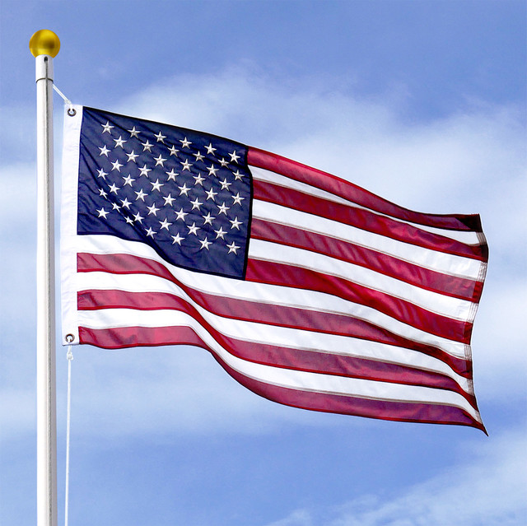
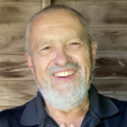
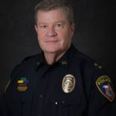
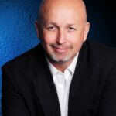
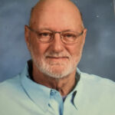
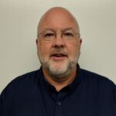
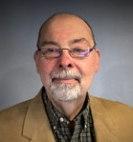
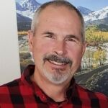
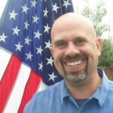
FY 22-23 FBSN Board of Directors
Carl Chinn, President
Ron Allen,
Board
Daniel Blevins, Treasurer
David Dixon, Chairman
Richard Hunt, Board
Mike Harvill, Board
Kurt Owen,
Vice Chair
Steve Burden, Board

Slide 2

State of the FBSN

Slide 3
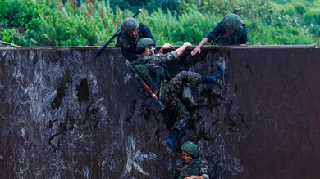
Accomplishments

Slide 4


Cause Machine
OLD SOFTWARE SERVICES
Join-it (Stripe)
Realm (Vanco)
Website (Stripe)
Events (PayPal and WePay)
Mass Communications (Constant Contact / Pay Pal)
NEW SOFTWARE SERVICES
FBSN Website Based (Stripe)
Mass Communications (Mail Chimp)

Slide 5
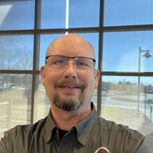
Warren Wells

Slide 6

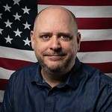
Sheepdog Monday

Slide 7
Best Practices Book

Slide 8

Security Best Practices Manual

Slide 9

Learning Management System

Slide 10
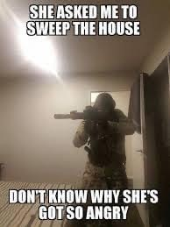
Training

Slide 11
Financial Stability

Slide 12
Permanent Board

Slide 13
Growth in Membership

Slide 14

SOS.23

Slide 15

Our promises to you for FY 23-24

Slide 16

Reflect Christ in all we do

Slide 17

Earn your Trust

Slide 18

Provide Transparency

Slide 19
SOS.24

Slide 20
SOS.25 Potential Locations

Slide 21
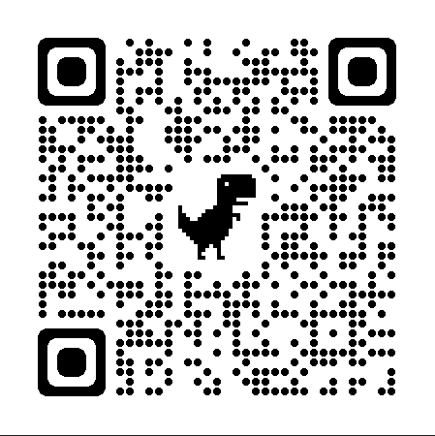
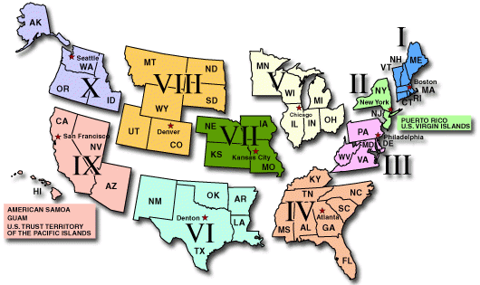
SOS 2024
Region VOTE
https://bit.ly/3zbVxRh

Slide 22

Member Questions & Comments

Slide 23
FBSN Member Comments

