Slide 1
Trafficking in Persons:
A Primer for
Healthcare Professionals
Jeff Barrows, D.O., M.A. (Bioethics)
Director of U.S. Training
Hope For Justice

Slide 2
Disclosure Information
Trafficking in Persons: A Primer for Healthcare Professionals
Dr. Jeff Barrows
I have no financial relationship to disclose.
AND
I will not discuss off label use and/or investigational use in my presentation.

Slide 3
Educational Objectives
At the conclusion of this program, participants should be able to:
Describe the scope and general characteristics of human trafficking in the U.S.
Recognize the common indicators and high-risk factors for human trafficking
Evaluate and assess whether a patient is a victim of human trafficking

Slide 4
Human Trafficking:
Legal Definition
Derived from federal legislation entitled:
The Trafficking Victims Protection
Act of 2000
TVPA
Notes:
Human trafficking is a devastating human rights violation that takes place not only internationally, but also here in the United States. It is, indeed, a form of modern-day slavery.
Traffickers use force, fraud or coercion to enslave their victims into situations involving sexual exploitation or forced labor.
Human trafficking is the fastest growing criminal industry in the world today, often operated by organized crime syndicates.

Slide 5
United States- TVPA
To be convicted of HT
Action:
Recruiting
Harboring
Transporting
Obtaining
Exploiting
Means:
Force
Fraud
Coercion
Purpose:
Sexual Exploitation
OR
Labor Exploitation

Slide 6
One Exception:
Minor <18 in commercial sex
Action:
Recruiting
Harboring
Transporting
Obtaining
Exploiting
Means:
Force
Fraud
Coercion
Purpose:
Sexual Exploitation

Slide 7
Human
Trafficking
Sexual Exploitation
Labor Exploitation

Slide 8
Human
Trafficking
Sex Trafficking
Labor Trafficking

Slide 9
Human
Trafficking
International
Victims
Domestic
Victims

Slide 10
Human
Trafficking
International
Victims
Domestic
Victims
Sex Trafficking
Labor Trafficking
Sex Trafficking
Labor Trafficking

Slide 11
Human
Trafficking
International
Victims
Domestic
Victims
Sex Trafficking
Labor Trafficking
Sex Trafficking
Labor Trafficking
Most Common

Slide 12
In 2012 TIP Report taken from 2012 ILO Report on Forced Labor; available online at: http://www.ilo.org/sapfl/Informationresources/ILOPublications/WCMS_182004/lang--en/index.htm

Slide 13
Worldwide Scope of Trafficking
In 2012 TIP Report taken from 2012 ILO Report on Forced Labor; available online at: http://www.ilo.org/sapfl/Informationresources/ILOPublications/WCMS_182004/lang--en/index.htm

Slide 15
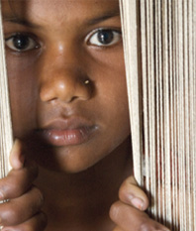
International Trafficking within the U.S.

Slide 16
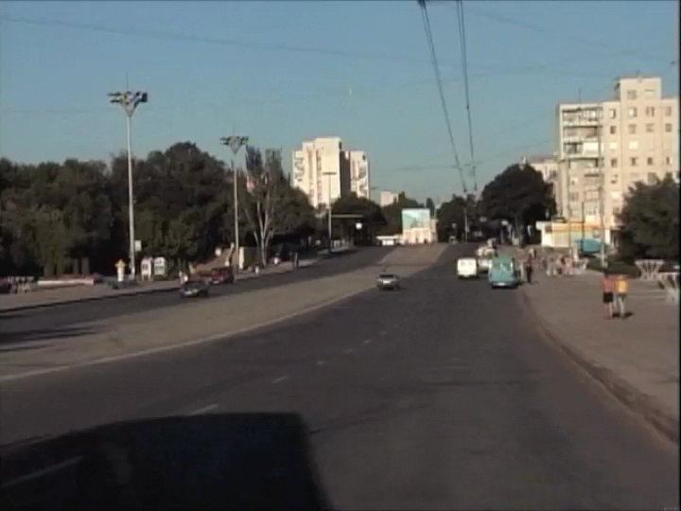

Slide 17

U.S. Estimate
Population 314 million
Prevalence = 1.5/1000
= 471,000 victims
= thousands/state

Slide 18
Location of Potential Trafficking Cases
“Human Trafficking Trends in the U.S.” National Human Trafficking Resource Center 2007-2012.

Slide 19

International Sex Trafficking Venues:
Strip/topless clubs
Asian massage parlors
Online escorts
Latino brothels
Major sporting events

Slide 20
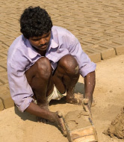
International labor trafficking venues:
Domestic servants
Sweatshops
Factories
Janitorial jobs
Construction sites
Restaurants
Hotels
Farm work
Notes:
As defined by the Trafficking Victims Protection Act of 2000, there are primarily two categories of human trafficking: Sex Trafficking and Labor Trafficking.
Sex trafficking operations occur in highly visible venues such as street prostitution, as well as more underground locations such as closed-brothel systems that operate out of residential homes.
Sex trafficking also takes place in a variety of public and private locations such as massage parlors, spas, strip clubs and other fronts for prostitution. Victims may start off dancing or stripping in clubs and are often coerced into more exploitative situations of prostitution and pornography.
Labor trafficking/exploitation involves domestic servitude; sweatshop factories; construction sites; migrant agricultural work; the fishing industry; janitorial jobs; the food service, hotel and tourist industries; and panhandling.
It is important to clarify that the crime of trafficking actually occurs when the victim is exploited for sex or forced labor – not when the victim is moved from one location to another.
As health care providers, you may come in contact with victims of sex or labor trafficking, but may mistake them as willing participants. It’s vital to look beneath the surface when encountering these types of patients and ask yourself if they are potential victims forced into these situations. As victims, they desperately need your help and compassion.

Slide 21
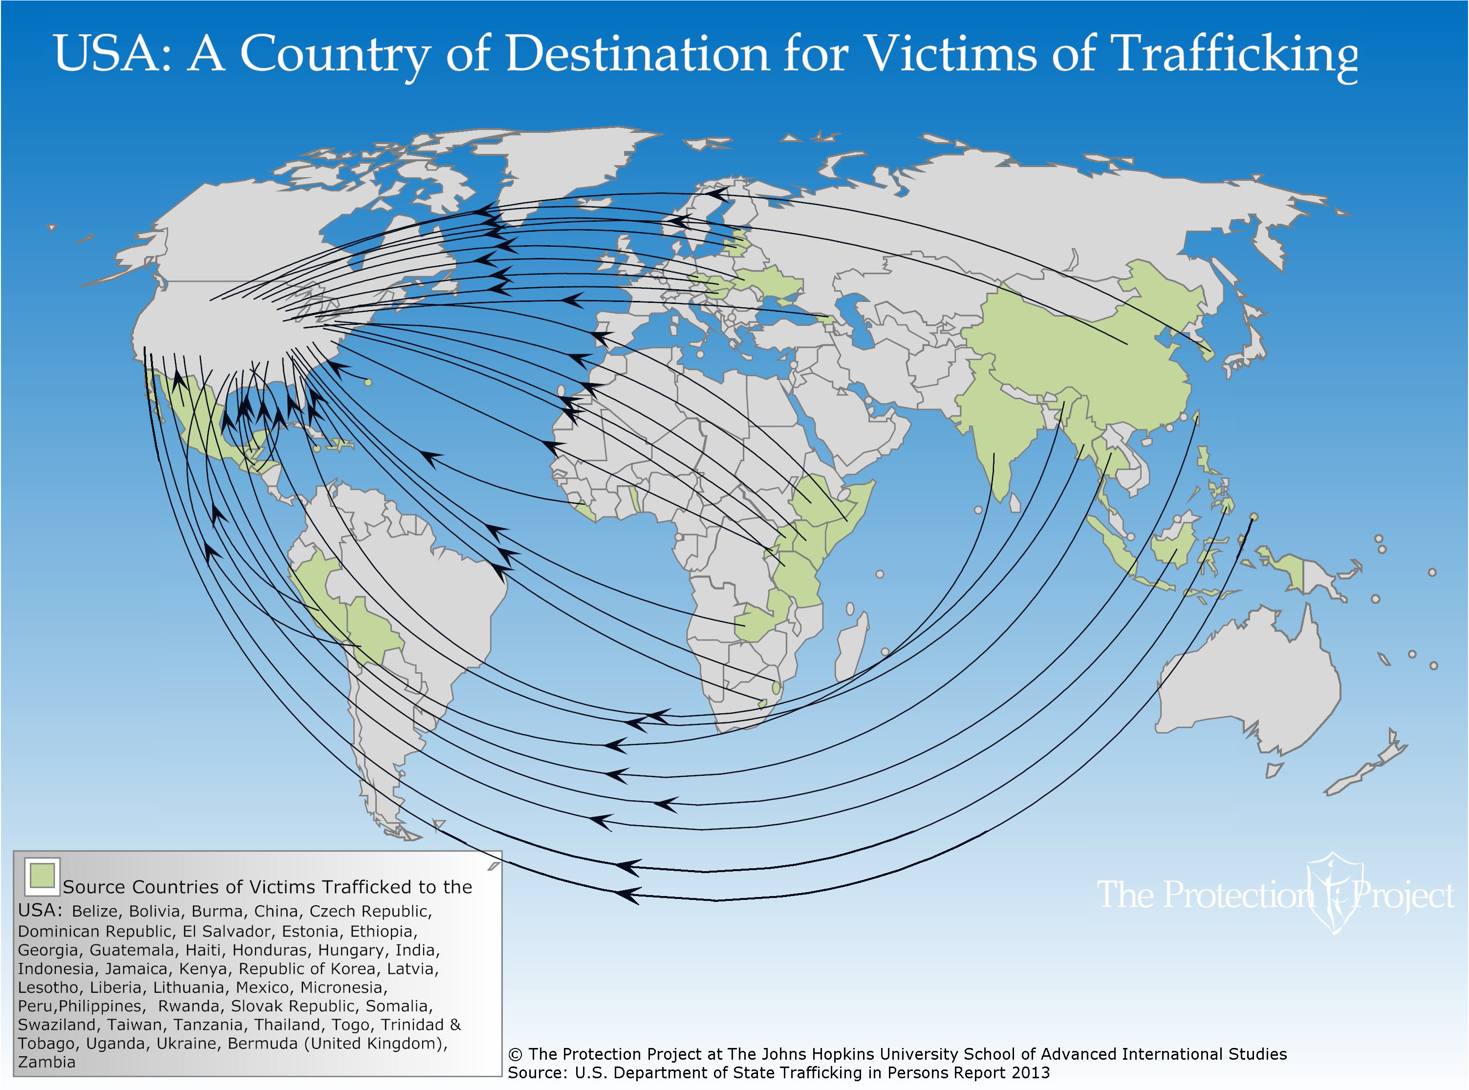

Slide 22
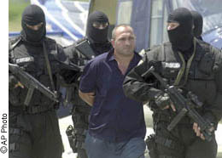
International Traffickers:
The Profile
Sophisticated
National, international networks
Organized crime syndicates

Slide 23
Domestic Trafficking
Trafficking of U.S. Citizens

Slide 24
Domestic Trafficking
Sex
Trafficking
>
Labor
Trafficking

Slide 25
Domestic Sex Trafficking Venues:
Street prostitution
Strip/topless clubs
Massage parlors
Online escorts
Truck stops
Major sporting events

Slide 26
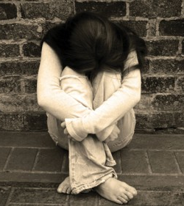
Domestic Minor Sex Trafficking
American teenagers who runaway to escape abuse in their homes
Often end up in prostitution
Girls as young as 12-14 years old caught in prostitution

Slide 27
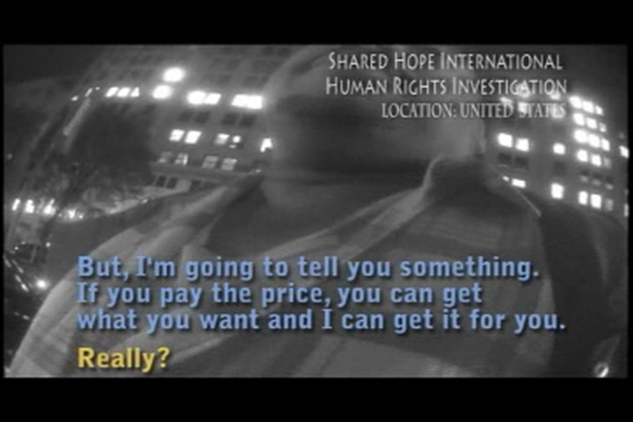

Slide 28
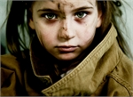
Vulnerable Youth
Physically abused
Sexually abused
Neglected
Abandoned
Youth of all races and socioeconomic strata

Slide 29
So why is this such a HUGE problem?
Money!
Average girl will make between $500 to $1000 per day selling sex

Slide 30
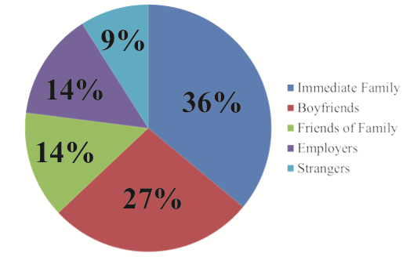
Who are the traffickers?
Homelessness, Survival Sex and Human Trafficking: As Experienced by the Youth of Covenant House New York ^{May 2013}

Slide 31
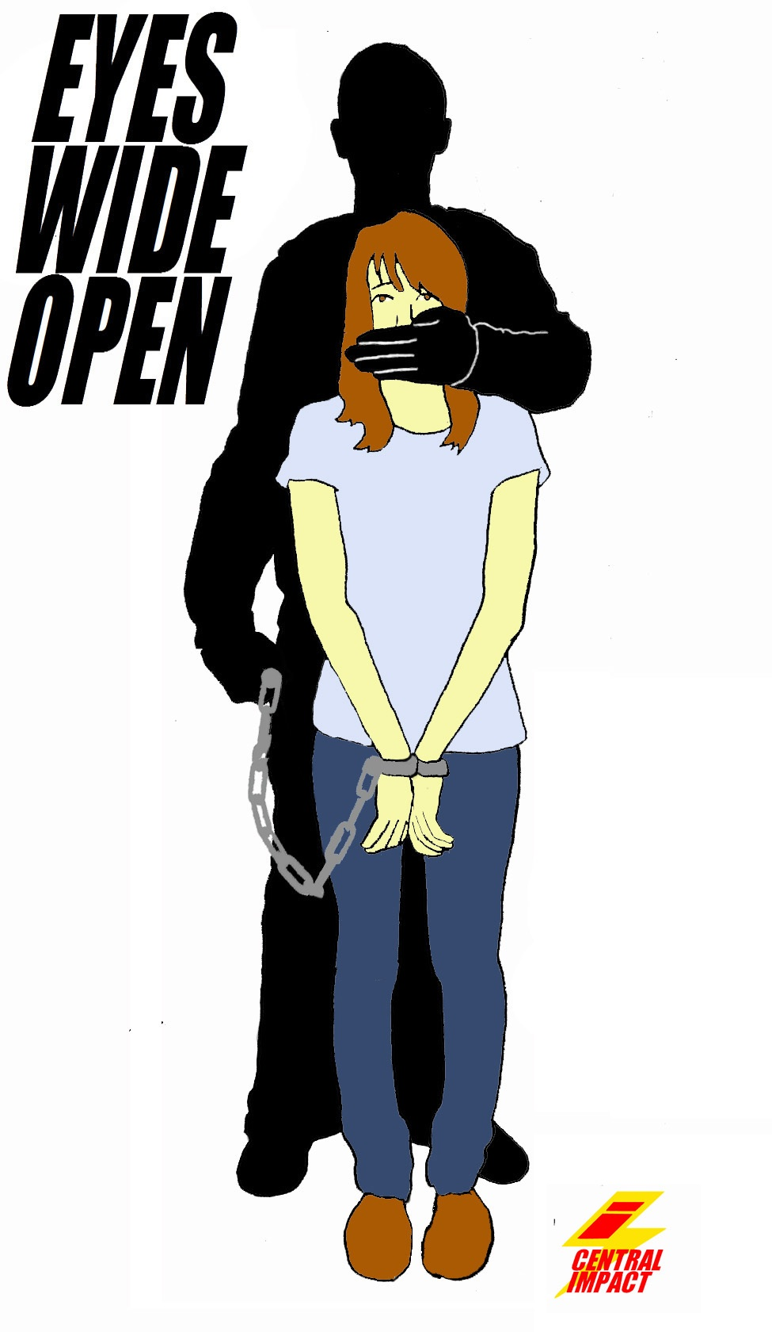
Recruitment- Gorilla Pimp
Tricks the girl into coming with him through lies
Uses brutal force and threats to control her
Less common type of trafficker

Slide 32

Recruitment- Finesse Pimp
Stage 1-Initial Contact
  Internet
  Malls
Stage 2- Seduction
Stage 3- Increasing control
Stage 4- Separation
Stage 5- Trauma bonding

Slide 33
“You promise a girl heaven, and she’ll follow you to hell”
Quote from a trafficker

Slide 34
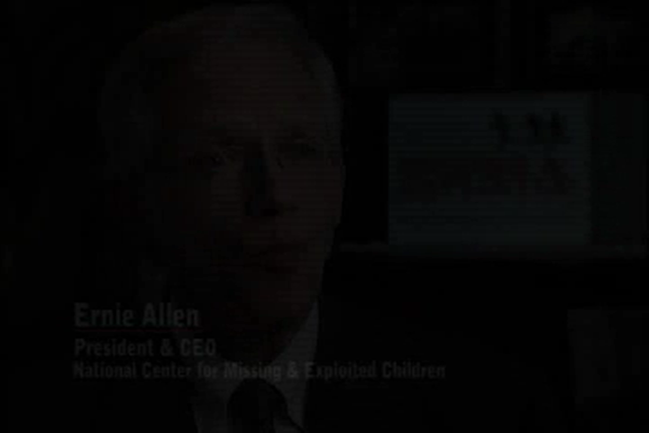

Slide 35

Where are the girls/women sold?
Internet
Backpage
Craig’s List
Eros.com
Facebook
My Space
Messaging services

Slide 36
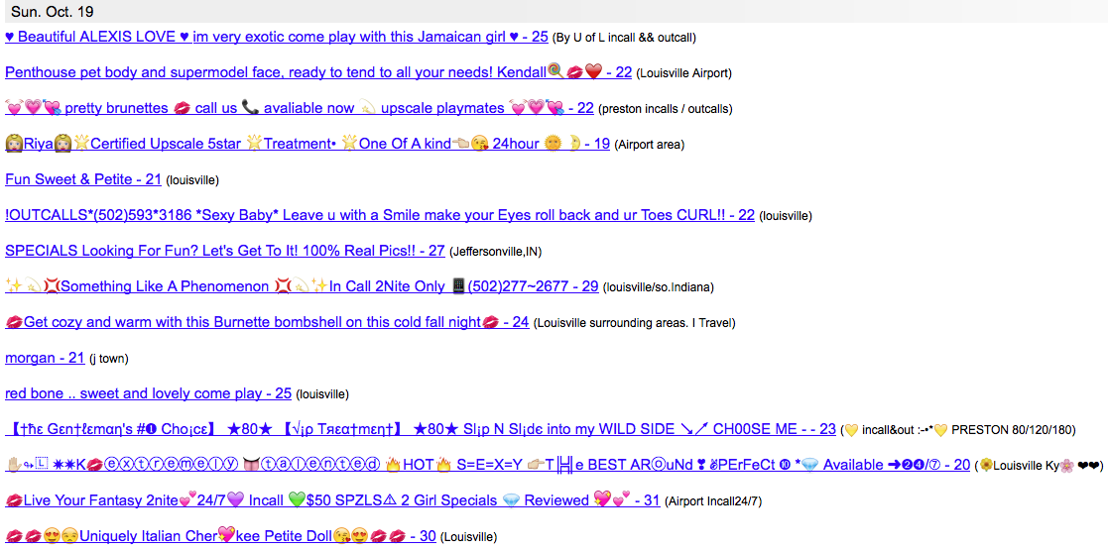
Backpage
Notes:
63 that day…

Slide 37

Male Victims
Under-recognized
Victims of both labor and sex trafficking
Commercially exploited males are perceived as less likely to be under the control of a trafficker

Slide 38
Role of
Healthcare Professionals
Finding and Caring for victims of human trafficking

Slide 39
International Sex Trafficking and Healthcare
Interviewed survivors and workers in LA
All survivors of international trafficking into U.S.
50% had visited a healthcare professional while in captivity
None were freed as a result of the encounter
Baldwin, SB, Eisenman DP, Sayles JN et al. “Identification of Human Trafficking Victims in Healthcare Settings”. Health and Human Rights (2011) (13) 1:1-14.

Slide 40
Domestic Sex Trafficking and Healthcare
87.8% of victims interviewed reported contact with healthcare system!
Lederer, L. and Wetzel, C.A. “The Health Consequences of Sex Trafficking and Their Implications for Identifying Victims in Healthcare Facilities”. (2014) The Annals of Health Law 23:1. 61-91.

Slide 41
Where victims are seen for healthcare
Hospital/Emergency rooms- 63%
Planned parenthood- 30%
Family physician- 23%
Urgent Care Clinic- 21%
Women’s clinic- 19%
Neighborhood clinic- 19%
Lederer, L. and Wetzel, C.A. “The Health Consequences of Sex Trafficking and Their Implications for Identifying Victims in Healthcare Facilities”. (2014) The Annals of Health Law 23:1. 61-91.

Slide 42
Sexually Exploited Youth
77% of youth identified as sexually exploited in Oakland CA stated that they see a physician regularly
  33% are currently on prescribed medications
  49% had been hospitalized
Missey Data Report- June 2009; available online at: http://www.misssey.org/documents/data_report_final.pdf

Slide 43
ED Personnel knowledge of trafficking
Assessed knowledge among ER personnel in 4 large emergency rooms in the NE
  Never had formal training on trafficking- 98%
  Knew what trafficking was- 74%
  Defining TIP
    19% were confident in ability to define TIP
    80% were hesitant to define TIP
  6% had treated a victim of trafficking
Chisholm-Straker, M., Richardson, LD., and Cossio, T. “Combating Slavery in the 21st century: The role of emergency medicine.” (2012) J Healthcare for Poor and Underserved 23:980-987.

Slide 44
ED Personnel knowledge of trafficking
  Whether HT was a problem in their ER:
    27% yes
    7% no
    59% unsure
  Confident in ability to identify a victim of trafficking- 5%
  Confident in ability to treat a victim of trafficking- 7%
Chisholm-Straker, M., Richardson, LD., and Cossio, T. “Combating Slavery in the 21st century: The role of emergency medicine.” (2012) J Healthcare for Poor and Underserved 23:980-987.

Slide 45
ED Personnel knowledge of trafficking
Results after taking 20 min training program:
  90% were confident in ability to define TIP
  54% were confident in ability to identify a victim of trafficking
  57% were confident in ability to treat a victim of trafficking
  93% said session was useful
Chisholm-Straker, M., Richardson, LD., and Cossio, T. “Combating Slavery in the 21st century: The role of emergency medicine.” (2012) J Healthcare for Poor and Underserved 23:980-987.

Slide 46
How to Identify and Treat Victims of Trafficking

Slide 47

How might a victim present?
I’m a
Trafficking
Victim
Notes:
Not like this.

Slide 48

Notes:
Think more along the lines of having to go after a drowning victim. These people have been brutalized, deceived, threatened, and brainwashed. Their families may have been threatened. Many of them may even be suffering from Stockholm Syndrome and will be reluctant to give up their captors. Their entire life is clandestine. Some will self identify, most will not.

Slide 49
S: Stop
O: Observe
A: Ask
R: Respond
SOAR to Health and Wellness Training
HHS
Office of Women’s Health
Administration of Children & Families

Slide 50
S: Stop- Consider is this trafficking?
O: Observe
A: Ask
R: Respond
SOAR to Health and Wellness Training
HHS
Office of Women’s Health
Administration of Children & Families

Slide 51
3 Categories of Indicators
Indicators of control
Strange Red Flags
Physical Indicators

Slide 52

Indicators of Control
  Other person with them may claim or actually be their boyfriend, uncle, husband, brother, sister, mom or dad.
Person controls conversation
  Corrects the patient
  Person does not allow the patient to answer questions
Person doesn’t want to leave

Slide 53
Indicators of Control
May exhibit body language displaying:
  Fear
  Anger
  Anxiety
  Submission
Not in control of ID documents
Not in control of money
Avoids eye contact

Slide 54
Indicators of Control
If alone, may exhibit the following:
  Frequent texting
  Phone calls during or after exam
  Appear in a hurry or unwarranted anxiety

Slide 55

Suspicious Red Flags
Clothing inconsistent with weather
Large amount of cash
Patient doesn’t know what city he/she is in
Patient unable to give address
Patient appears to be lying about age

Slide 56
Suspicious Red Flags
Patient is a very poor historian
History keeps changing
All the pieces do not seem to fit together
Do you get the feeling you’re not getting the whole story
Late presentation

Slide 57
Clinical Presentations- Jill
16 year old female named Jill is brought into the ER by her brother. Upon presentation to the ER desk, Jill is barely able to stand and appears about to faint. For that reason, the triage nurse is immediately notified and Jill and her brother are brought back into an exam room.
Upon questioning, Jill’s brother does all the talking. He states that Jill began bleeding just in the past hour and he brought her immediately into the ER. He further adds that 2 years prior, their parents were killed in an automobile accident, and since that time, Jill has been suffering from schizophrenia and delusions.
Brief initial exam of Jill shows some blood on her clothing, pale conjunctiva and skin, but Jill is conscious.
You ask her questions and she just seems to stare off into space.

Slide 58
Clinical Presentations- Jill
The following are all possible signs of trafficking except:
Jill’s general condition suggests blood loss greater than stated by the brother
The brother does all the talking
Jill’s alleged schizophrenia
Jill’s strange affect when questioned

Slide 59
Clinical Presentations- Jill
The following are all possible signs of trafficking except:
Jill’s general condition suggests blood loss greater than stated by the brother
The brother does all the talking
Jill’s alleged schizophrenia Correct Answer
Jill’s strange affect when questioned

Slide 60
S: Stop
O: Observe- Examine the patient
A: Ask
R: Respond
SOAR to Health and Wellness Training
HHS
Office of Women’s Health
Administration of Children & Families

Slide 61
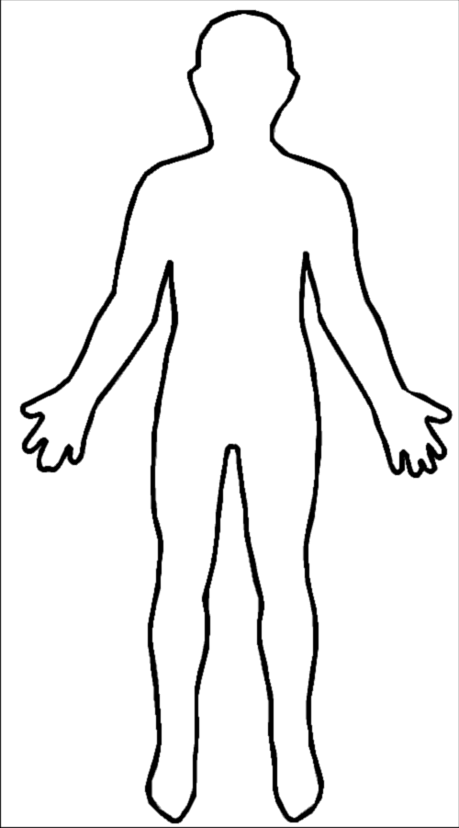
Physical Indicators- International
Psychological stress, PTSD, evidence of substance abuse
Sleep deprivation
Malnutrition
Dental trauma
Tuberculosis
Lack of Immunization
Physical trauma such as burns
GI Somatic complaints
Evidence of sexual trauma
STI’s including HIV/AIDS
Atopic skin rashes
Konstantopoulos, W.M., Ahn, R., Alpert AJ. et. al. “An International Comparative Public Health Analysis of Sex Trafficking of Women and Girls in Eight Cities: Achieving a More Effective Health Sector Response”. J Urban Health: Bulletin of the New York Academy of Medicine. (2013) Vol. 90 (6):1194-1204.

Slide 62
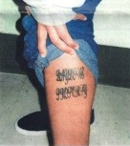
Physical Indicators- Domestic
Psychological stress, PTSD, evidence of substance abuse
Sleep deprivation
weight loss
Dental trauma
Physical trauma such as burns
GI Somatic complaints
Evidence of sexual trauma
STI’s including HIV/AIDS
Highly abnormal pap
Frequent need for pregnancy test
Tattoos signifying “property of”

Slide 63
Clinical Presentations- Jill
Physical examination of Jill reveals the following:
Scars on both wrists and ankles
Scar on her neck across her larynx
Enlarged uterus
Recent manipulation of the cervix
Active uterine bleeding
Laboratory evaluation reveals the following:
+ HCG
Anemia

Slide 64
Clinical Presentations- Jill
All of the following physical findings suggest trafficking except:
Scars on wrists and ankles
Scar on the neck
Recent trauma/manipulation of cervix
Enlarged uterus

Slide 65
Clinical Presentations- Jill
All of the following physical findings suggest trafficking except:
Scars on wrists and ankles
Scar on the neck
Recent trauma/manipulation of cervix
Enlarged uterus Correct answer

Slide 66
Clinical Presentations- Jill
A tentative diagnosis of retained products of conception following attempted abortion is made.
Jill is taken to the OR, D & C performed along with blood transfusions.
Due to profound anemia, Jill is left in hospital overnight.

Slide 67
What do you do if you suspicions increase after the exam?

Slide 68
S: Stop
O: Observe
A: Ask
R: Respond
SOAR to Health and Wellness Training
HHS
Office of Women’s Health
Administration of Children & Families

Slide 69
Separate the Patient from the Potential Trafficker

Slide 70
Preparations to Ask
If the patient is a victim of trafficking, they are probably highly traumatized, requiring:
  Trauma-informed staff to establish trust
  Staff to take whatever time possible
Provide translation as necessary

Slide 71
Preparations to Ask
Trauma-informed personnel to consider:
  Hospital social worker
  SANE/SAFE nurse
  Specially trained trauma nurse

Slide 72
International Human Trafficking: Questions
Can you leave your work or job situation if you want?
When you are not working, can you come and go as you please?
Have you been threatened with harm if you try to quit?
Has anyone threatened your family?
Notes:
This slide lists sample indirect questions you may want to ask your patient to determine if she/he may, indeed, be a trafficking victim.

Slide 73
International Human Trafficking: Questions
What are your working or living conditions like?
Where do you sleep and eat?
Do you have to ask permission to eat, sleep or go to the bathroom?
Is there a lock on your door or windows so you cannot get out?
Notes:
This slide lists sample indirect questions you may want to ask your patient to determine if she/he may, indeed, be a trafficking victim.

Slide 74
Domestic Human Trafficking: Questions
Have you been asked to have sex with multiple men each night?
Do you have to meet a quota of money before you can safely return home?
Has someone forced you to perform sexually before a camera?
Has anyone taken sexually suggestive photo’s of you to post on the Internet?

Slide 75
What do you do if you discover someone who may be a victim of trafficking?

Slide 76
S: Stop
O: Observe
A: Ask
R: Respond
SOAR to Health and Wellness Training
HHS
Office of Women’s Health
Administration of Children & Families

Slide 77
To respond properly, you need to prepare in advance

Slide 78
Step 1- Local Research
Research local anti-trafficking contacts
  Call the Trafficking Information and Referral Hotline 1.888.3737.888.
  Local community resources working specifically to help victims of trafficking
  Contact these local agencies and find out about local law enforcement
  Call the Department of Homeland Security Hotline at: 866-347-2423
Notes:
The first step in providing assistance to trafficking victims is to call the Trafficking Information and Referral Hotline. However, if the victim is at risk for imminent harm, first call the local police.
This hotline will help you determine if you have encountered victims of human trafficking, will identify local resources available in your community to help victims, and will help you coordinate with local social service organizations to help protect and serve victims so they can begin the process of restoring their lives.
Victims of human trafficking who are non-U.S. citizens are eligible to receive a special visa and benefits and services through the Trafficking Victims Protection Act to the same extent as refugees. Victims who are U.S. citizens are already eligible to receive many of these benefits.

Slide 79
Step 2- Designate personnel
Assign a member of the staff to interface with:
  Local, state, and federal law enforcement
  Local community service providers
  Child protective services
Gather information on the local trafficking problem
Notes:
The first step in providing assistance to trafficking victims is to call the Trafficking Information and Referral Hotline. However, if the victim is at risk for imminent harm, first call the local police.
This hotline will help you determine if you have encountered victims of human trafficking, will identify local resources available in your community to help victims, and will help you coordinate with local social service organizations to help protect and serve victims so they can begin the process of restoring their lives.
Victims of human trafficking who are non-U.S. citizens are eligible to receive a special visa and benefits and services through the Trafficking Victims Protection Act to the same extent as refugees. Victims who are U.S. citizens are already eligible to receive many of these benefits.

Slide 80
Step 3- Gather information
Local trafficking problem
  International
  Domestic
Local law enforcement response capability
How they suggest you respond and report to them
Notes:
The first step in providing assistance to trafficking victims is to call the Trafficking Information and Referral Hotline. However, if the victim is at risk for imminent harm, first call the local police.
This hotline will help you determine if you have encountered victims of human trafficking, will identify local resources available in your community to help victims, and will help you coordinate with local social service organizations to help protect and serve victims so they can begin the process of restoring their lives.
Victims of human trafficking who are non-U.S. citizens are eligible to receive a special visa and benefits and services through the Trafficking Victims Protection Act to the same extent as refugees. Victims who are U.S. citizens are already eligible to receive many of these benefits.

Slide 81
Step 4- Condense into a protocol
List of local trafficking indicators
How to separate potential victim and trafficker
Designated interviewer
Provision of interpreting services
Steps to ensure security/safety of victim
Guidelines for when to intervene
Protocol for when patient refuses intervention
Notes:
The first step in providing assistance to trafficking victims is to call the Trafficking Information and Referral Hotline. However, if the victim is at risk for imminent harm, first call the local police.
This hotline will help you determine if you have encountered victims of human trafficking, will identify local resources available in your community to help victims, and will help you coordinate with local social service organizations to help protect and serve victims so they can begin the process of restoring their lives.
Victims of human trafficking who are non-U.S. citizens are eligible to receive a special visa and benefits and services through the Trafficking Victims Protection Act to the same extent as refugees. Victims who are U.S. citizens are already eligible to receive many of these benefits.

Slide 82
Step 5-Train your staff
Notes:
The first step in providing assistance to trafficking victims is to call the Trafficking Information and Referral Hotline. However, if the victim is at risk for imminent harm, first call the local police.
This hotline will help you determine if you have encountered victims of human trafficking, will identify local resources available in your community to help victims, and will help you coordinate with local social service organizations to help protect and serve victims so they can begin the process of restoring their lives.
Victims of human trafficking who are non-U.S. citizens are eligible to receive a special visa and benefits and services through the Trafficking Victims Protection Act to the same extent as refugees. Victims who are U.S. citizens are already eligible to receive many of these benefits.

Slide 83
Clinical Presentations- Jill
All of the following are reasonable responses to Jill’s situation at this point except:
Obtain a psychiatric consult
Have social services interview Jill
Dial 911
Notify a local anti-trafficking service provider

Slide 84
Clinical Presentations- Jill
All of the following are reasonable responses to Jill’s situation at this point except:
Obtain a psychiatric consult
Have social services interview Jill
Dial 911
Notify a local anti-trafficking service provider

Slide 85
Hope For Justice is available to assist hospitals and clinics in their efforts to develop a response protocol

Slide 86
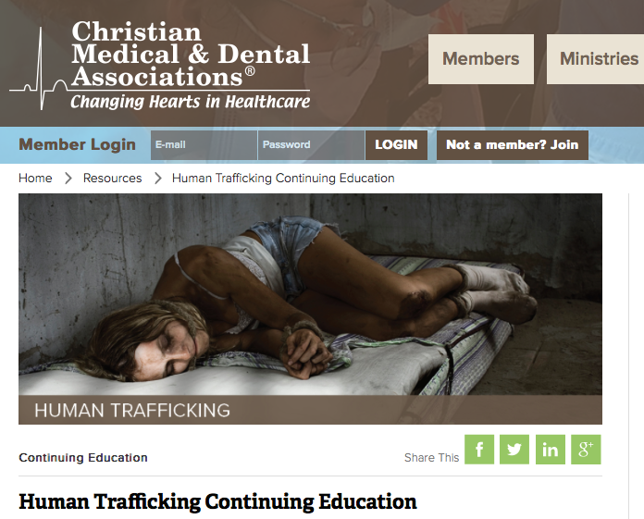
www.cmda.org/tip

Slide 87
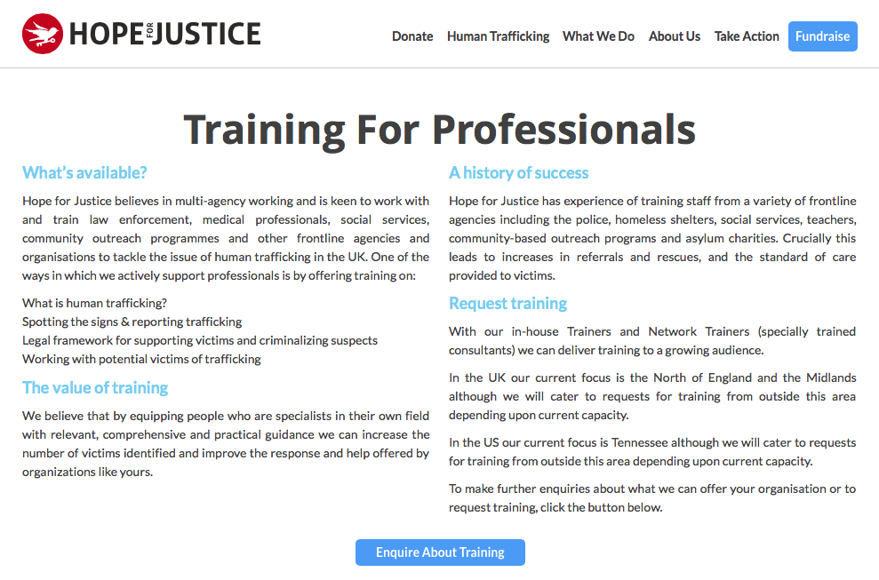
Hopeforjustice.org/training

Slide 88


