Slide 1

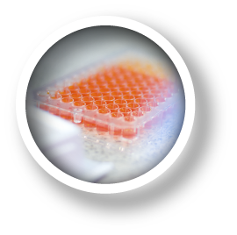
Ebola!
GMCH, Louisville
November 2014
fischer.phil@mayo.edu

Slide 2
Ebola!
Lots of potential responses:
fear, adventure, sorrow
An example of global health activity
Today’s session:
a clinical overview
stories, answers, involvement

Slide 3
Objective
Be able to identify and describe the
epidemiology,
clinical presentations,
management,
and prevention
of Ebola virus disease.

Slide 4
Disclaimer
I have never cared for someone with Ebola.
I used to hope to see a case.
This year, I had several chances - but declined.

Slide 5
What’s with Ebola? Is it a big deal?

Slide 6
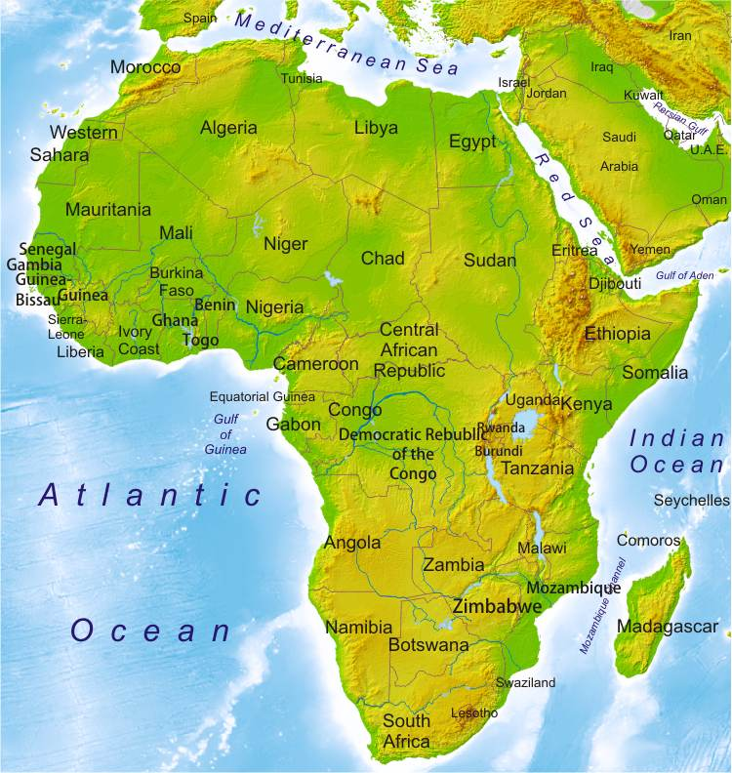

Slide 8
Ebola Outbreak, 3-1-2014 to 10-31-2014
Cases Deaths
Guinea 1667 1018
Liberia 6535 2413
Sierra Leone 5338 1510
Nigeria 20 8
Mali 1 1
Senegal 1 0
Spain 1 0
USA 4 1
TOTAL 13567 4951

Slide 9
Meanwhile in DR Congo…
A different Ebola virus
66 cases with 49 deaths (8 healthcare workers)
No positive test since October 8, 2014
“Free” if no new cases by November 19, 2014

Slide 10
Is Ebola Like the Worst Thing Ever?

Slide 11
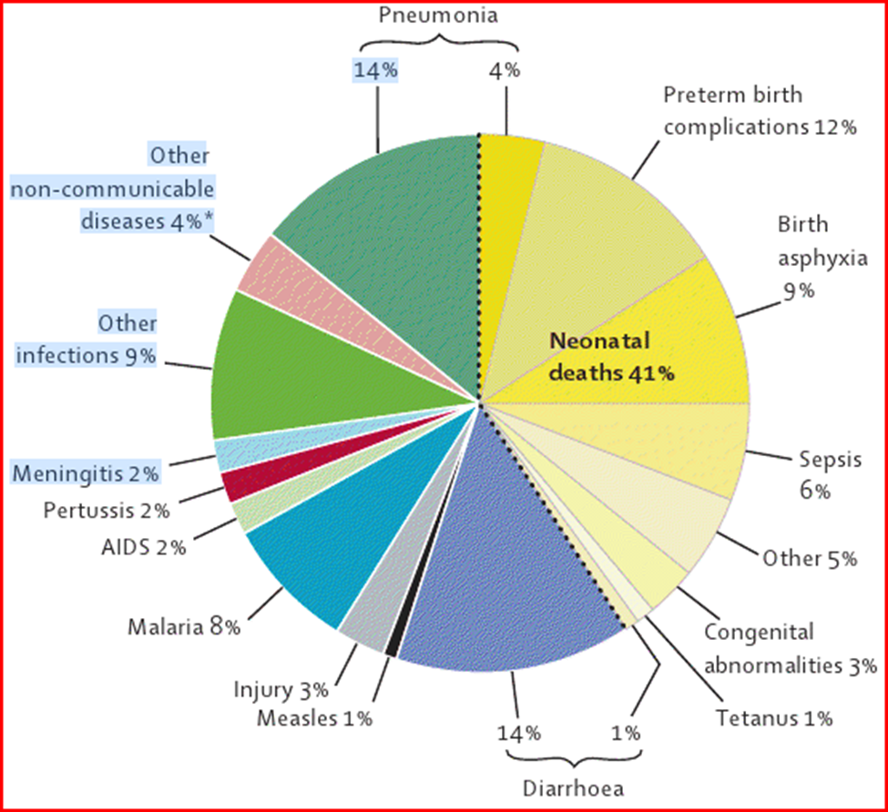
Is Ebola Like the Worst Thing Ever?
~ 18,000 pre-schoolers die every day

Slide 12
Where Did Ebola Come From?
Year Location Death-Cases
1976 Zaire – DR Congo 280-318
1976 Sudan 151-284
[‘85-’91 Zaire - DR Congo me]
1995 DR Congo 250-315
2000 Uganda 224-425
2007 DR Congo 187-264
also Gabon, Ivory Coast
So Africa, Rep Congo

Slide 13
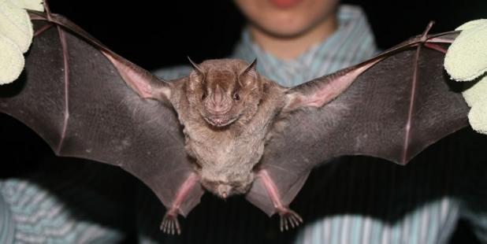
Where Does Ebola Still Come From?
Fruit Bats
H2H – Human-To-Human Spread (body fluids)

Slide 14
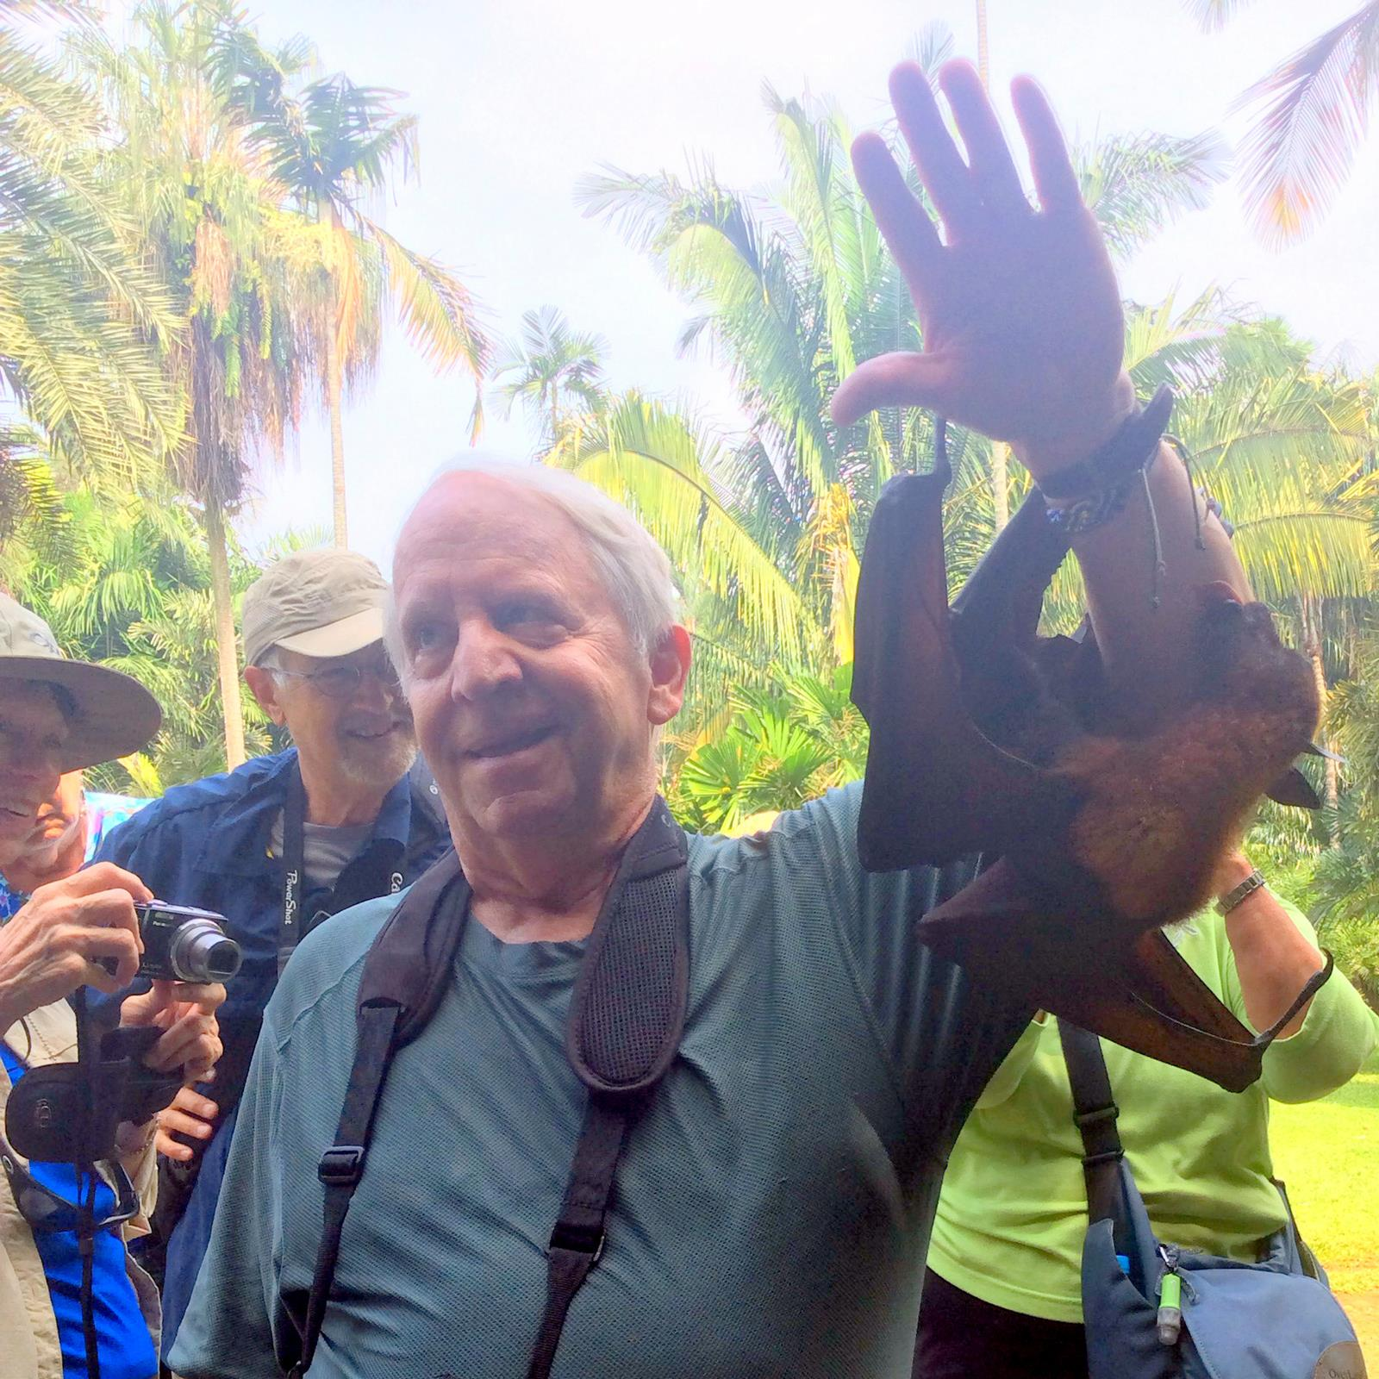

Slide 15
I want to travel from Guinea to your meeting in Greece. Is that okay?

Slide 16
I want to travel from Guinea to your meeting in Greece. Is that okay?
How do you respond?

Slide 17
I want to travel from Guinea to your meeting in Greece. Is that okay?
Source: Fruit Bat and/or Human-to-Human
Incubation: 2-21 days
So: No contact with fruit bat or sick person for 21 days

Slide 18
I want to travel from Guinea to your meeting in Greece. Is that okay?
Source: Fruit Bat and/or Human-to-Human
Incubation: 2-21 days
So: No contact with fruit bat or sick person for 21 days
But: What counts as a “sick person”?

Slide 19
I want to travel from Guinea to your meeting in Greece. Is that okay?
Source: Fruit Bat and/or Human-to-Human
Incubation: 2-21 days
So: No contact with fruit bat or sick person for 21 days
But: What counts as a “sick person”?
Fever, feels bad?
Bleeding (rectal, oral, other)?

Slide 20
A man arrives at a mission hospital in rural Guinea with fever and bloody diarrhea. The hospital has no isolation rooms. Should they see the patient or send him elsewhere?

Slide 21
A man arrives at a mission hospital in rural Guinea with fever and bloody diarrhea. The hospital has no isolation rooms. Should they see the patient or send him elsewhere?
1. They referred him to a regional hospital.
2. They got gowns and masks and developed an isolation management plan.

Slide 22
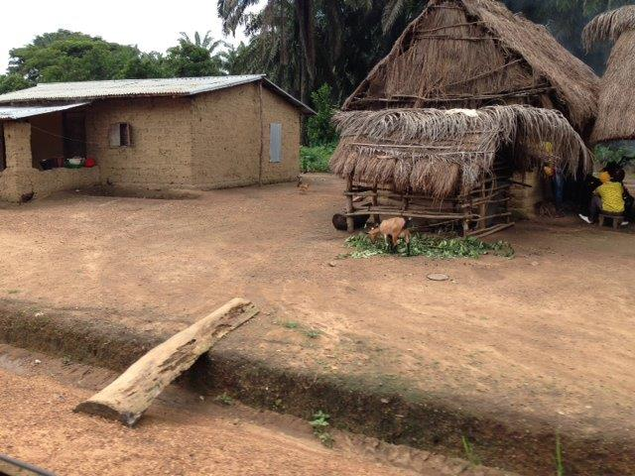
Logistics Matter!

Slide 23
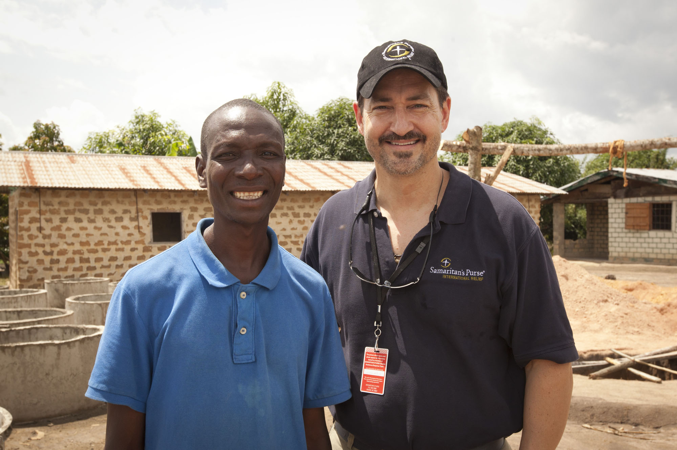

Slide 24
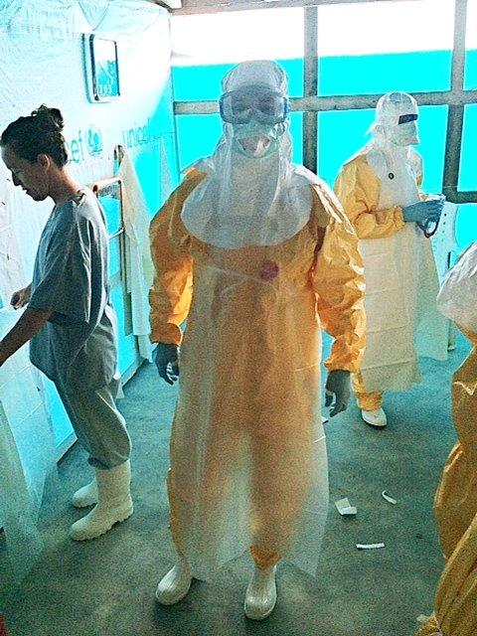

Slide 25
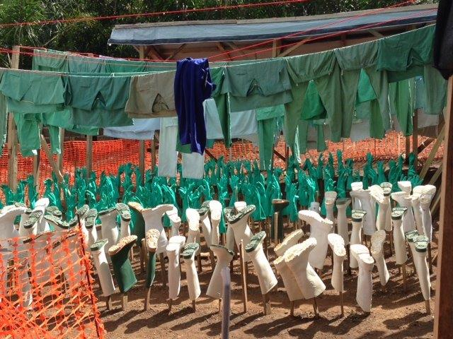

Slide 26
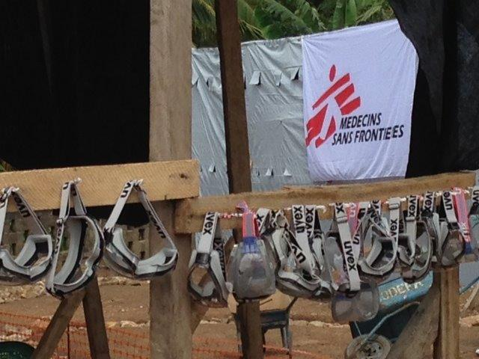

Slide 27
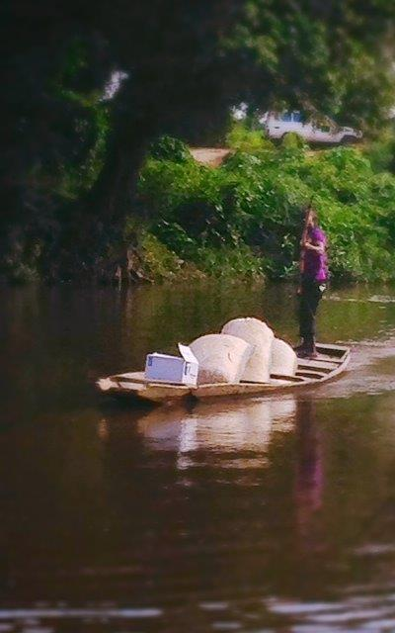
Rapid Diagnostics?

Slide 28
We treat other serious viral infections.
Why can’t we treat Ebola?

Slide 29
Supportive Care Works (sometimes)!

Slide 30
Treatment Options
1. BCX4430, a novel synthetic adenosine analogue that inhibits RNA polymerase function, aborts Ebola disease in mice and Marburg disease in monkeys. Nature 2014. doi: 10.1038/nature13027
2. Favipiravir, a pyrazinecarboxamide derivative, blocks viral replication in cell culture and treats mice. Antiviral Res 2014 Apr;104:153-5.
3. Monoclonal antibodies. Hum Vaccin Immunother 2014;10(4).
ZMapp works in monkeys. Nature 8-2014

Slide 31
Monoclonal Antibodies in Humans
Four patients, three (??) survived.
WHO cleared experimental use as ethical.
New Engl J Med supportive, 8-20-2014.
Were “saves” coincidental or because of treatment?

Slide 32
Can’t We Prevent Ebola?
Avoid bat contact and contact with infected humans (alive or dead).
Vaccines have some success in primates. Expert Rev Vaccines 2014 Apr;13(4):521-31.

Slide 33
Consultation on Potential Ebola Therapies and Vaccines
Geneva, Switzerland
September 4-5, 2014
? Use serum from Ebola survivors
> Vaccines (2) being tested, medications advancing

Slide 34
Questions & Discussion fischer.phil@mayo.edu

