Slide 1

Bylaws Changes and Corrections

Slide 2

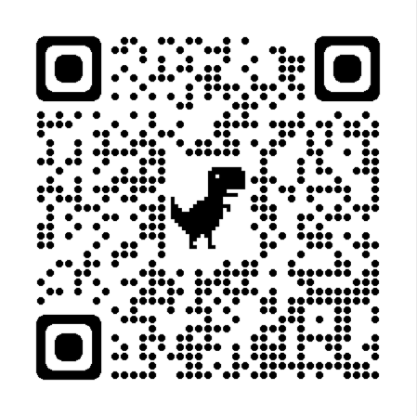
By Laws Changes Vote (get a new QR Code)
List changes
Put a website here

