Slide 1

Duane Crumb, Founder & Director
PO Box 9361
Fort Myers, FL 33902 USA
Duane@HIVHope.net
© 2012 Duane Crumb, HIVHope

Slide 2
It’s about
PEOPLE

Slide 3
Sources
HIVHope.net
info@HIVHope.net
www.AIDSmap.com
Prevention-News@cdcnpin.org
www.yahoogroups.com/group/aids-africa
It’s about people!

Slide 4
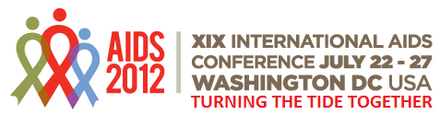
TasP
PrEP
Cure for HIV
The end of AIDS
TnT
PEP
MMC
Vaccine
Microbicide
B+ Option

Slide 5
Treatment as Prevention
TasP
HIVHope.net
What’s needed for success?
Availability of ARVs
Medical personnel
Testing – viral load, CD₄ count
Suppressed viral load
Is it realistic?
Where?
It’s about people!

Slide 6
Quantity in the blood
AIDS
Viral Load
Antibodies
T-Cell/
CD₄ Count
Level at which antibodies can be detected in the blood
Time
Years
Date of infection
Window Period

Slide 7
Quantity in the blood
AIDS
Viral Load
Antibodies
T-Cell/
CD₄ Count
Level at which antibodies can be detected in the blood
Time
Years
Date of infection
Window Period

Slide 8
PEP & PrEP
HIVHope.net
Post Exposure Prophylaxis
In use in health care settings & rape scenarios
What about people at high risk?
Pre-Exposure Prophylaxis
Does it work?
Who should receive?
Cost?
Resistance?
It’s about people!

Slide 9
Test & Treat
TNT
HIVHope.net
What’s involved?
Does it work?
Concerns
Cost
Scale up
Adherence
It’s about people!

Slide 10
Prevention of Mother to Child Transmission
PMTCT
HIVHope.net
Antiretrovirals (ARV)
Other strategies
B+ Option
Cost (Cost effectiveness)
Adherence (esp. after giving birth)
Keep mother alive to raise the children
It’s about people!

Slide 11
HIVHope.net
Adverse Birth Outcomes on ARV
Low birth weight
Pre-term delivery
Small for Gestational Age
Still birth
Neonatal death
It’s about people!

Slide 12
America
HIVHope.net
Most HIV-Positive Americans Lack Regular Care
Only 25 percent of Americans with HIV have their virus under control, according to a CDC report released at the 19th International AIDS Conference.
African Americans –
81% have been diagnosed
34% are retained in care
29% have been prescribed antiretroviral therapy
21% are virally suppressed
Americans ages 25-34 who have HIV -
72% have been diagnosed
28% receive regular care and
15% are virally suppressed.
It’s about people!

Slide 13
Africa faces spike in older people living with HIV
HIVHope.net
By Justine Gerardy (AFP) – 19 October 2012
Sub-Saharan Africa is likely to see a more than 200 percent increase in the number of older people living with HIV in the next 30 years, thanks to improvements in lifesaving treatment.
Three million people aged 50 or older currently live with HIV in sub-Saharan Africa and that figure is expected to rise to 9.1 million by 2040.
"It's mainly driven by the fact that people are being treated with antiretroviral drugs and therefore will survive to be old," said Cumming.
The faster roll-out of treatment has allowed people to live longer with the disease as in first world countries, but HIV is still a leading cause of death.
"In countries with a high prevalence of HIV in sub-Saharan Africa, HIV is still an important cause of mortality in older people," said Cumming, pointing to a study in rural Kenya which found it had caused nearly one fifth of deaths.
Policy makers on the continent were also not acknowledging the growing age group which has doctors and others working in the field worried.
"It's a huge problem that is being ignored. It's a huge problem for the older people themselves who are often going to miss out on treatment so they are going to die sooner than they should otherwise do," said Cumming.
Guiseppe Liotta of the University of Rome said many patients in Africa arrived for treatment when very sick, and often with other diseases and conditions like malnutrition and anaemia, but that HIV-caused deaths fell a year into treatment.
"HIV positive elderly would need special attention because they seem to start ARV treatment very late," said Liotta.
An analysis by HelpAge International found only 68 of 119 country progress reports submitted to United Nations agency UNAIDS had some data or reference to older people. Only four had details on prevalence for those living with HIV.
"The lack of data just means we don't have a clear picture of what's happening in relation to HIV and ageing and that means that we can't respond appropriately," said the NGO's Rachel Albone.
Anti-AIDS data and policy efforts in Africa have overwhelmingly focused on the 15- to 49-year-old grouping.
Older people know less about the disease and are less likely to be tested, and face difficulties with access to care, said Cumming.
"I guess it's reasonable to focus on young people because that is where most new infections occur. But there seems to be an attitude that people over 50 don't have sex and therefore can't get infected and that's clearly incorrect."
Infection prevalence levels among older people in the region is four percent, only one percent lower than that of people under 50.
According to UNAIDS, access to treatment in sub-Saharan Africa had reached 37 percent in 2009, up from two percent seven years earlier.
It’s about people!

Slide 14
Cheap, Ultra-Sensitive Colour Test Spots Early HIV, Cancer
HIVHope.net
Medical News Today (10.29.12
Researchers at the Imperial College of Science, Technology and Medicine, London, United Kingdom, have developed a test to detect viruses and disease biomarkers. This new test is reported to be 10 times more sensitive than the best available today. Researchers Roberto de la Rica and Molly Stevens were able to detect an HIV biomarker called p24 in blood samples as well as low levels of prostate specific antigen (PSA), an early indicator for prostate cancer. The test can be reconfigured to detect known biomarkers of other viruses and diseases. De la Rica noted that the test will enable previously undetectable HIV infections and indicators of cancer to be picked up.
The biosensor analyzes serum derived from blood in a disposable, transparent container. The enzyme label of an enzyme-linked immunosorbent assay (ELISA) controls the growth of gold nanoparticles and generates colored solutions. If the marker is present, the reaction generates irregular clumps of nanoparticles that give off a blue color in the solution. If it is absent, the nanoparticles separate into ball-like shapes that give off a reddish color. These reactions can be seen with the naked eye.
De la Rica states that this test could be significantly cheaper than those presently being used, and may result in more widespread HIV testing in developing countries. The team plans to approach not-for-profit global health organizations for assistance to develop and manufacture the test for distribution, particularly in low-income countries.
The study titled, “Plasmonic ELISA for the Ultrasensitive Detection of Disease Biomarkers with the Naked Eye,” was published online in the journal Nature Nanotechnology, 28 October 2012; DOI:10.1038/nnano.2012.186.
It’s about people!

Slide 15
Doctors Don't Ask, Patients Don't Tell
HIVHope.net
"Doctors Don't Ask, Patients Don't Tell" MedPage Today (10.20.12)
Study in New York City - Medical practitioners’ reluctance to ask patients to take the test as a major barrier to universal HIV testing, which is recommended by national, state, and local institutions.
Only eight of 87 patients meeting criteria for screening were asked. When surveyed, medical residents found:
81% were not familiar with the CDC recommendation that all patients should be screened
75% understood the difference between “opt in” and “opt out” testing
43% believed written consent was necessary for rapid testing; and
38% did not know how to order the rapid HIV screening test.
Reasons given for not pursuing HIV testing:
Too busy,
Thought the test not clinically relevant, or
Believed the patient was not at risk.
Study in Chicago found less than 32% of the residents asked patients about HIV screening,
24% working with in-patients asked, and
16% in the emergency department asked.
Many said that they did not ask because they thought that patients would refuse.
Others said the physicians may not be able to properly counsel patients who test positive.
It’s about people!

Slide 16
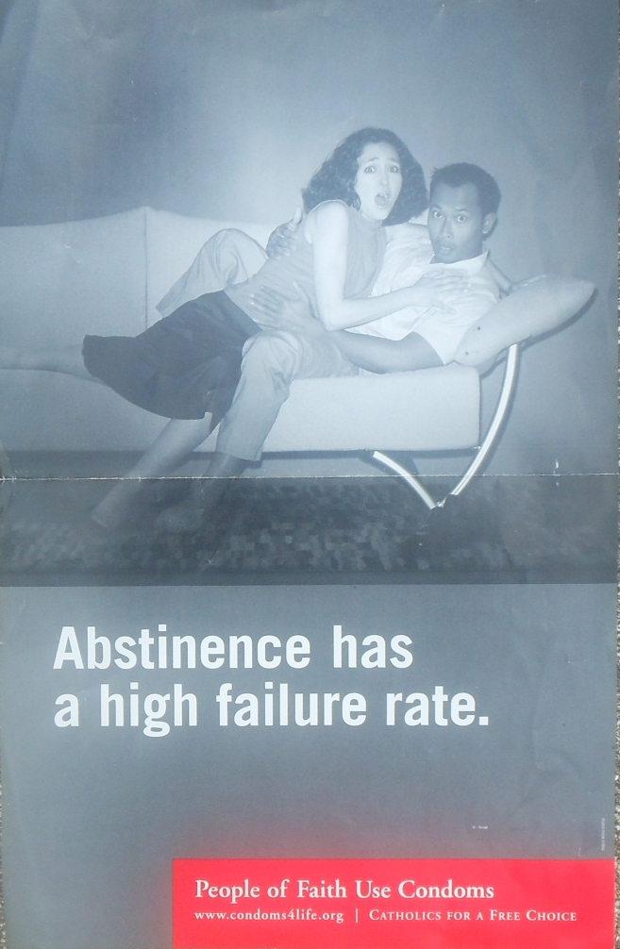
HIVHope.net
Abstinence
“Abstinence doesn’t work, so use condoms”
It’s about people!

Slide 17
“Abstinence doesn’t work, so use condoms”: Critical responses to Christian youth sexualities and HIV prevention in Africa
By Tsitsi Masvawure
Ourbeen intrigued by for some time now. These are our limited understanding of the experiences of young people who choose to, and successfully, abstain from sex and the lack of HIV prevention interventions for sexually abstinent youth. Unfortunately, the concept of abstinence has become so politically incorrect and emotionally charged in the HIV world that there is great reluctance to acknowledge that every single day around the world young people are successfully delaying sexual debut—if not until they are married, for one more month or for one more year, and so on.for many Christian youth, pre-marital abstinence is not simply something that one does, but is what one is. Abstinence is not an action one performs or a “behavior”, but is an integral part of one’s identity as a Christian. A critical first step towards developing an appropriate HIV prevention response for sexually-abstinent youth, for me, therefore, is one that takes into account the fact that pre-marital sexual abstinence is, for some young people, deeply embedded into their sense of self. Such an approach would lead us down a substantially different path than an approach which views abstinence strictly as a behavior because the focus would not be on changing the behavior but on understanding what the behavior means or signifies for the individuals practicing it.
As a society, our default position on abstinence is that it is a ludicrous and impossible expectation. Our failure and refusal to accept and support young people’s decisions to remain sexually abstinent until marriage must be viewed as a failure to recognize and support a specific type of youth sexual agency.

Slide 18
Duane Crumb, Founder & Director
PO Box 9361
Fort Myers, FL 33902 USA
Duane@HIVHope.net
© 2012 Duane Crumb, HIVHope

Slide 19
Sources
HIVHope.net
info@HIVHope.net
www.AIDSmap.com
Prevention-News@cdcnpin.org
www.yahoogroups.com/group/aids-africa
It’s about people!

Slide 20
Stigma
PMTCT – B+ - lower adherence after giving birth
Abstinence
Religions play positive role in African AIDS/Church telling patients to end medication
Other risks (stomach & esophageal cancer, heart trouble
US doctors don’t ask, don’t tell
Multivitimins don’t help
Africa faces spike in older people w/HIV
TasP
PrEP/Truvada
TnT
PEP
Fewer Americans supressing HIV/Most positive Americans lack regular care
Cure/Vaccine
Nurse-centered care
Discordancy
Arab world facing HIV epidemic

